Slide 1

Chapter 3.1 Content-based Recommender Systems

Slide 2

What is content of an item?

Slide 3
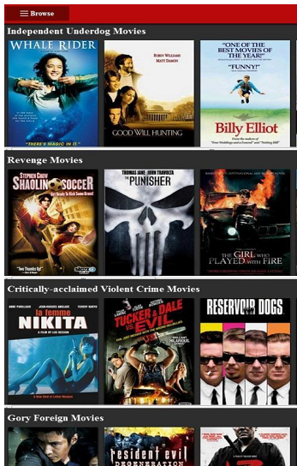
What is content of an item?
Explicit attributes or characteristics (e.g., for a movie)
Genre: Action / adventure
Feature: Bruce Willis
Year: 1995
Textual content (e.g., for a book):
Title
Description
Table of content

Slide 4
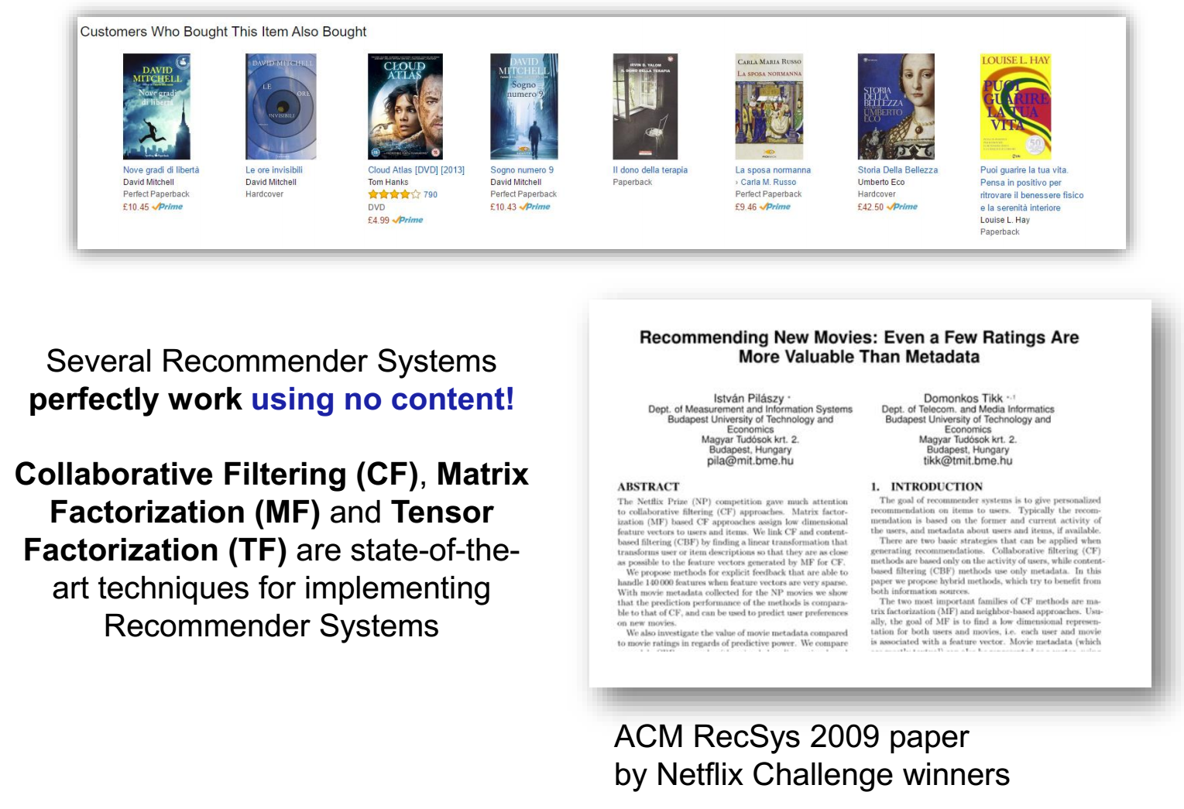
Why do we need content?
Notes:
Content can tackle some issues of Collaborative Filtering. These slides are taken from “Recent Developments of Content-Based RecSys”, by Marco de Gemmis, Pasquale Lops, Cataldo Musto, Fedelucio Narducci, Giovanni Semeraro; ACM Summer School on Recommender Systems, 2017.

Slide 5
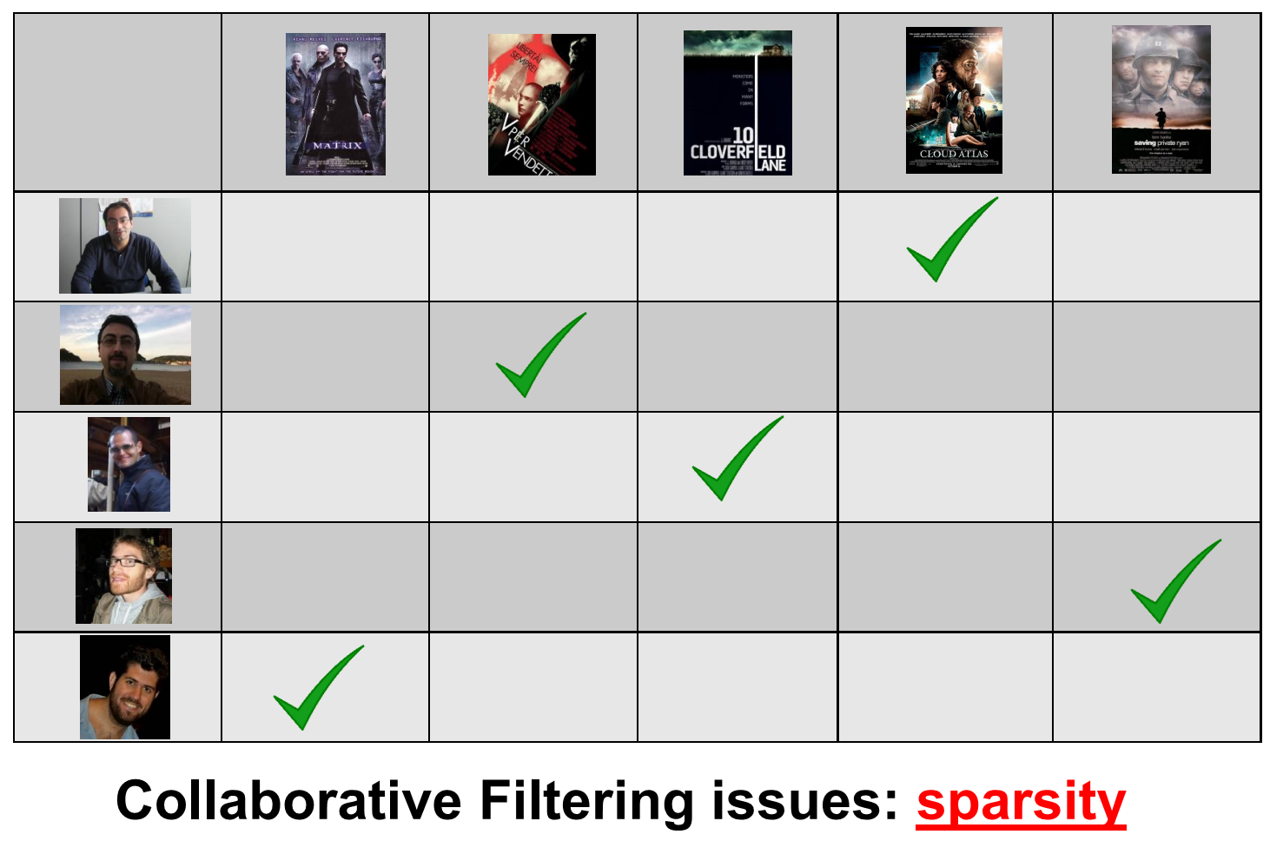
Why do we need content?

Slide 6
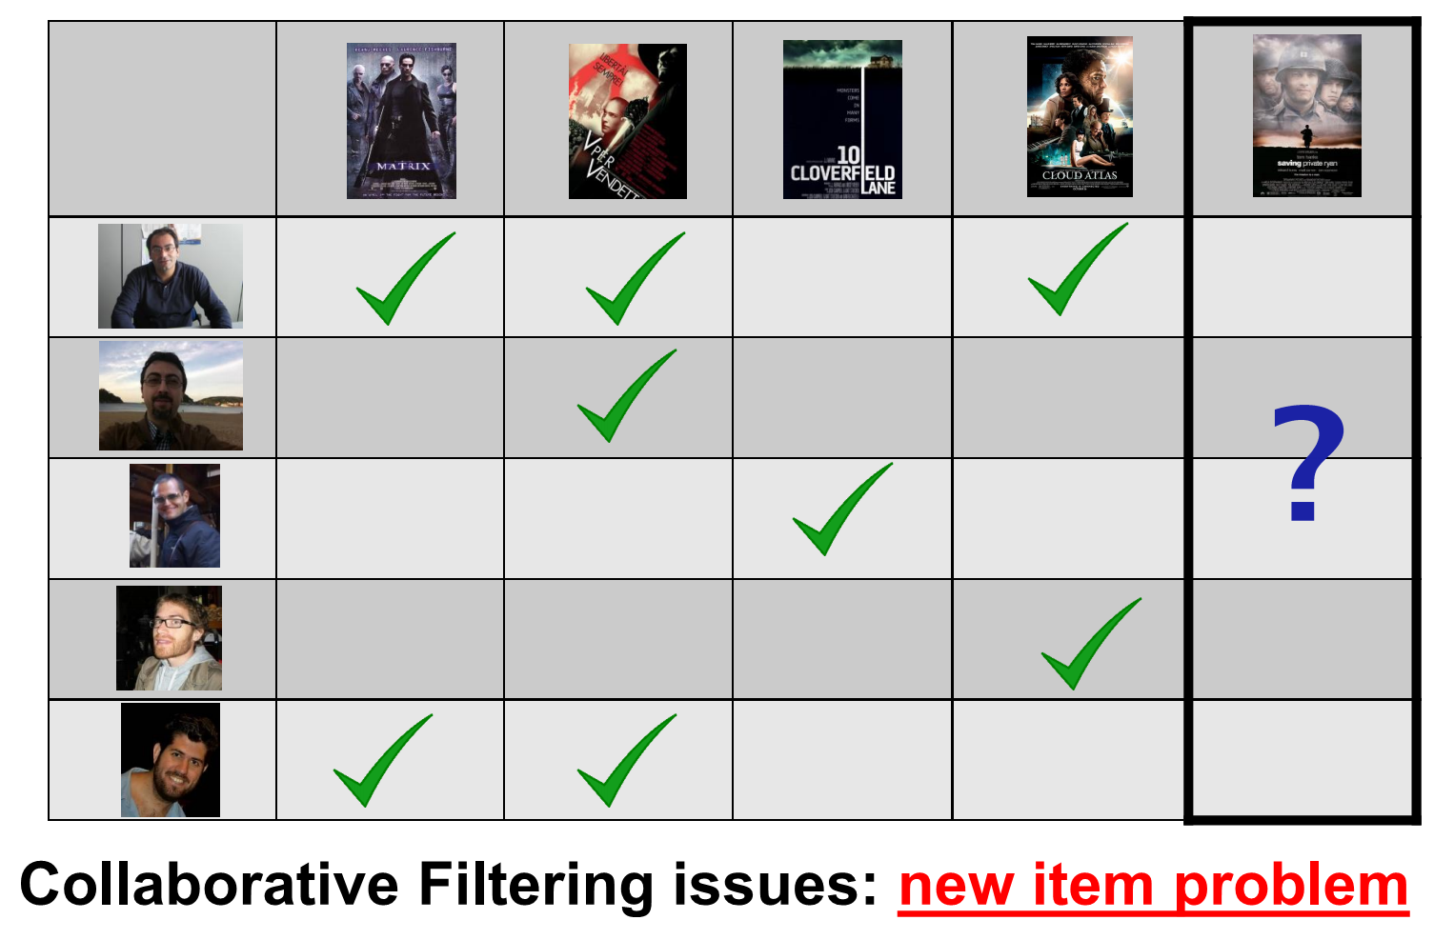
Why do we need content?

Slide 7
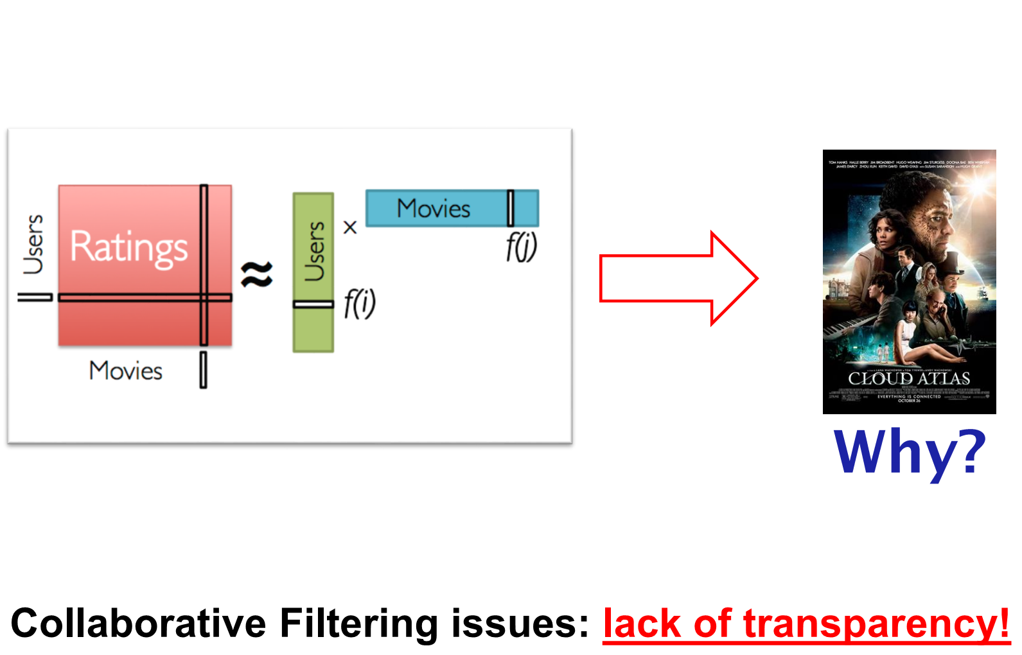
Why do we need content?

Slide 8
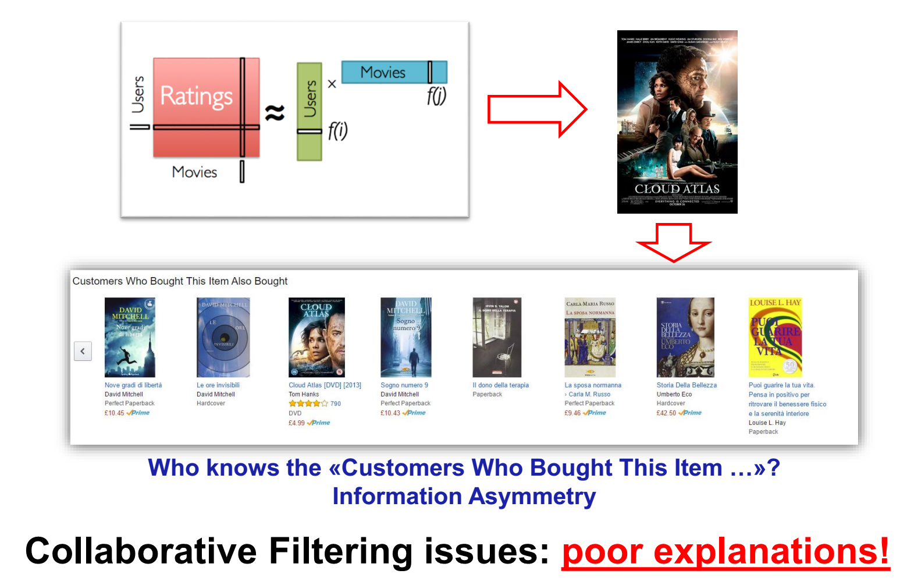
Why do we need content?

Slide 9
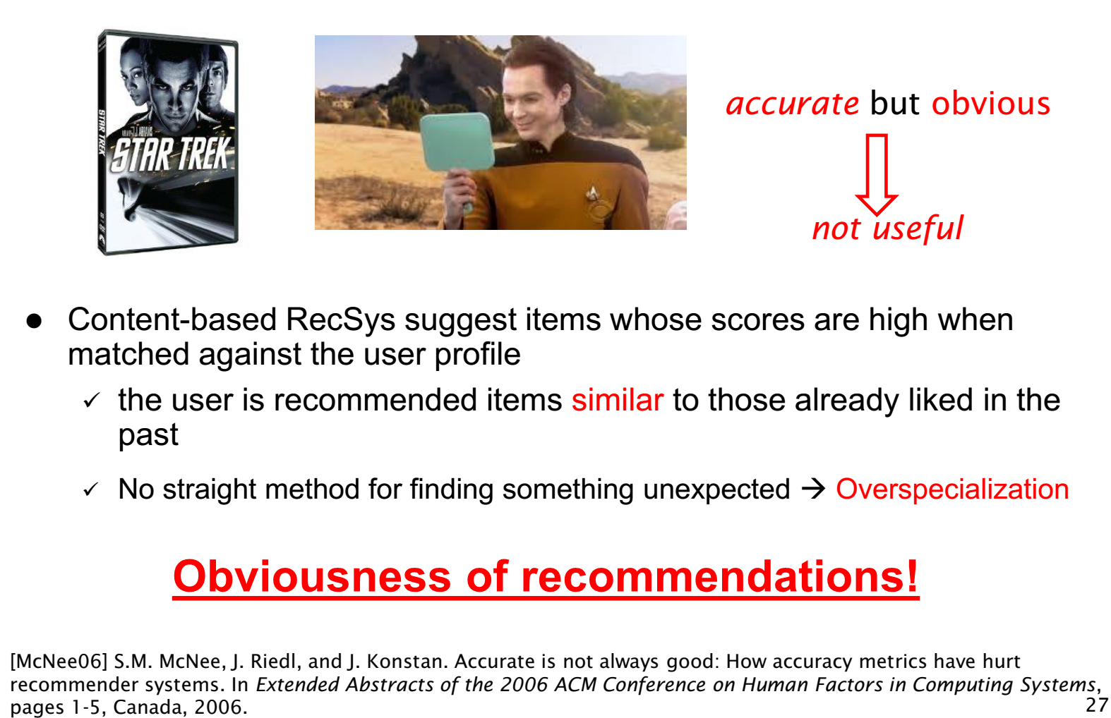
Why do we need content?

Slide 10
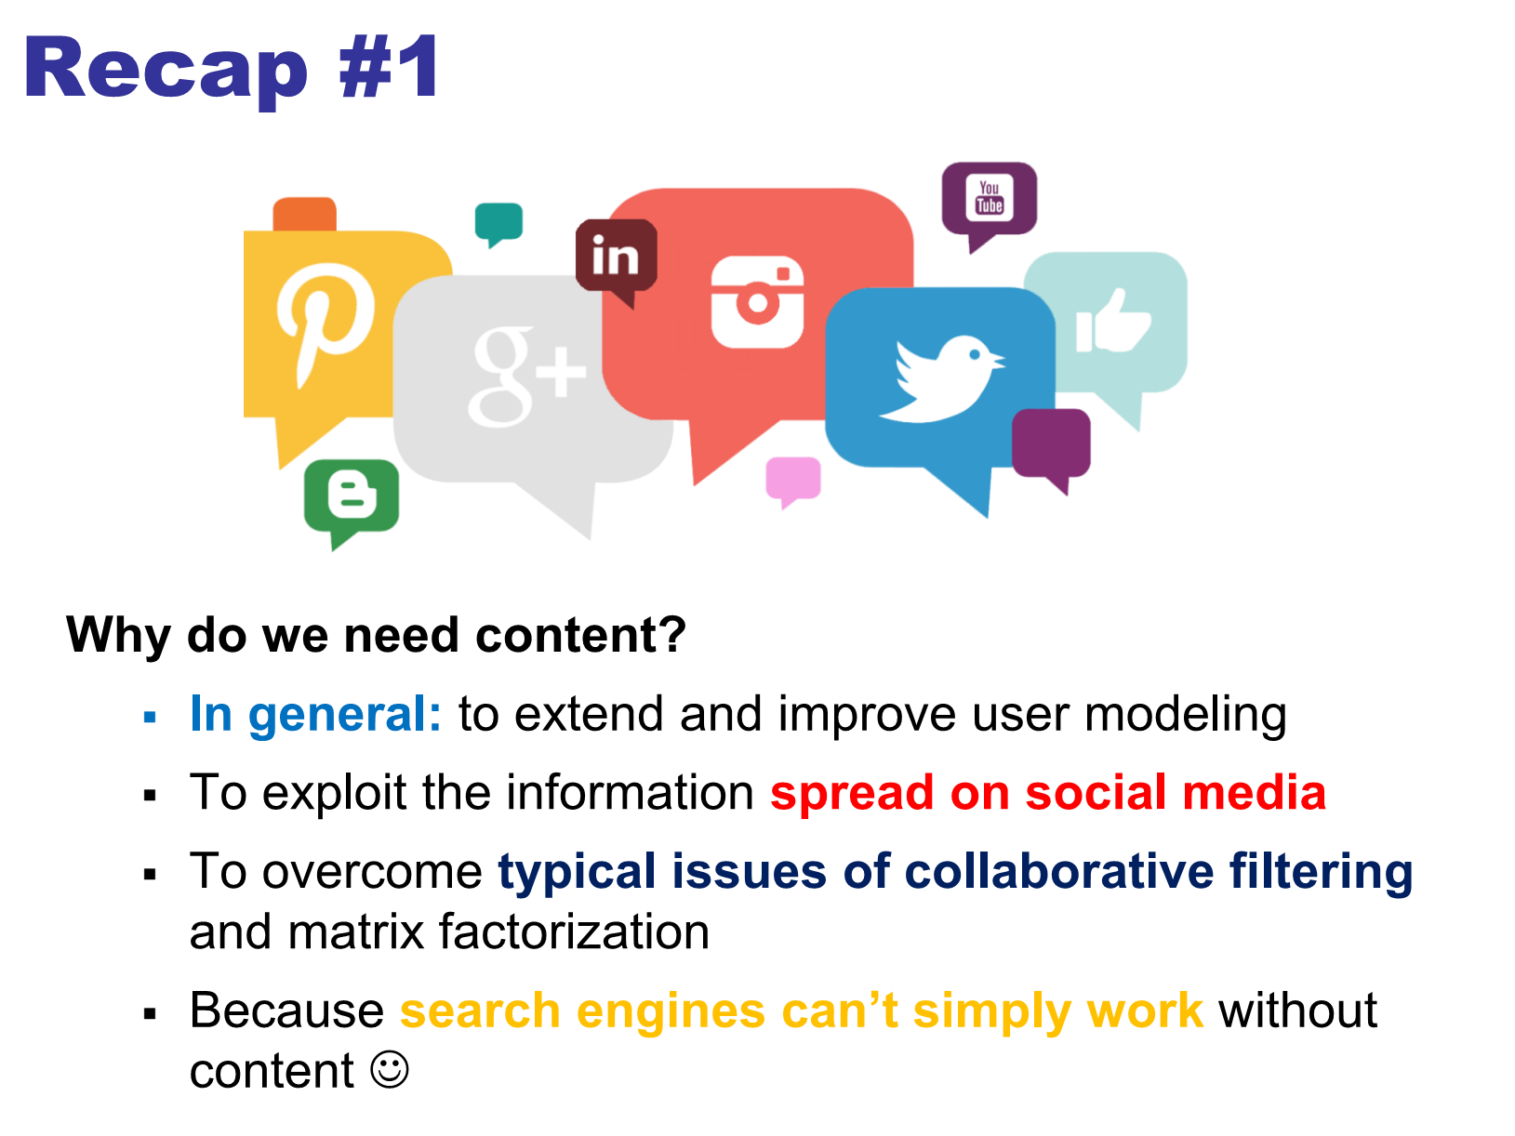

Slide 11
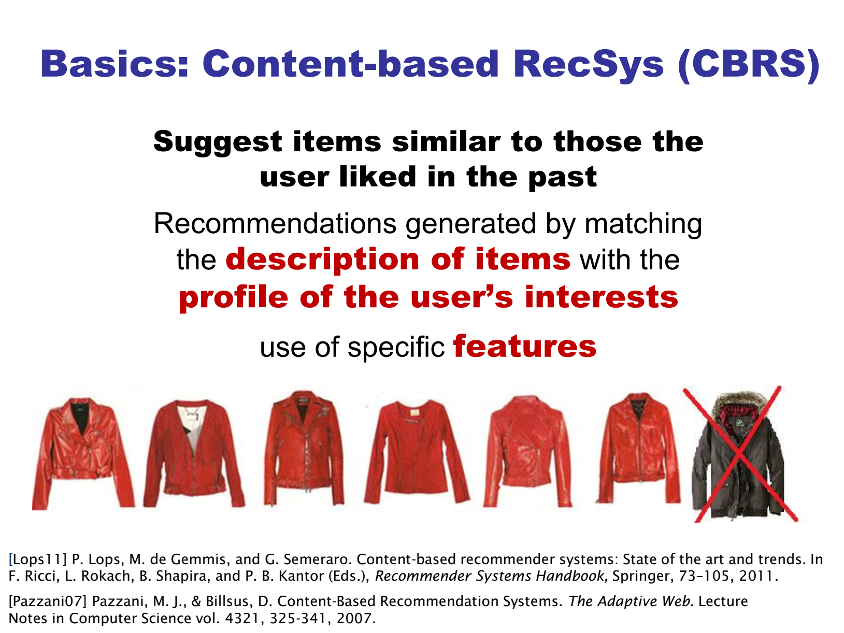

Slide 12
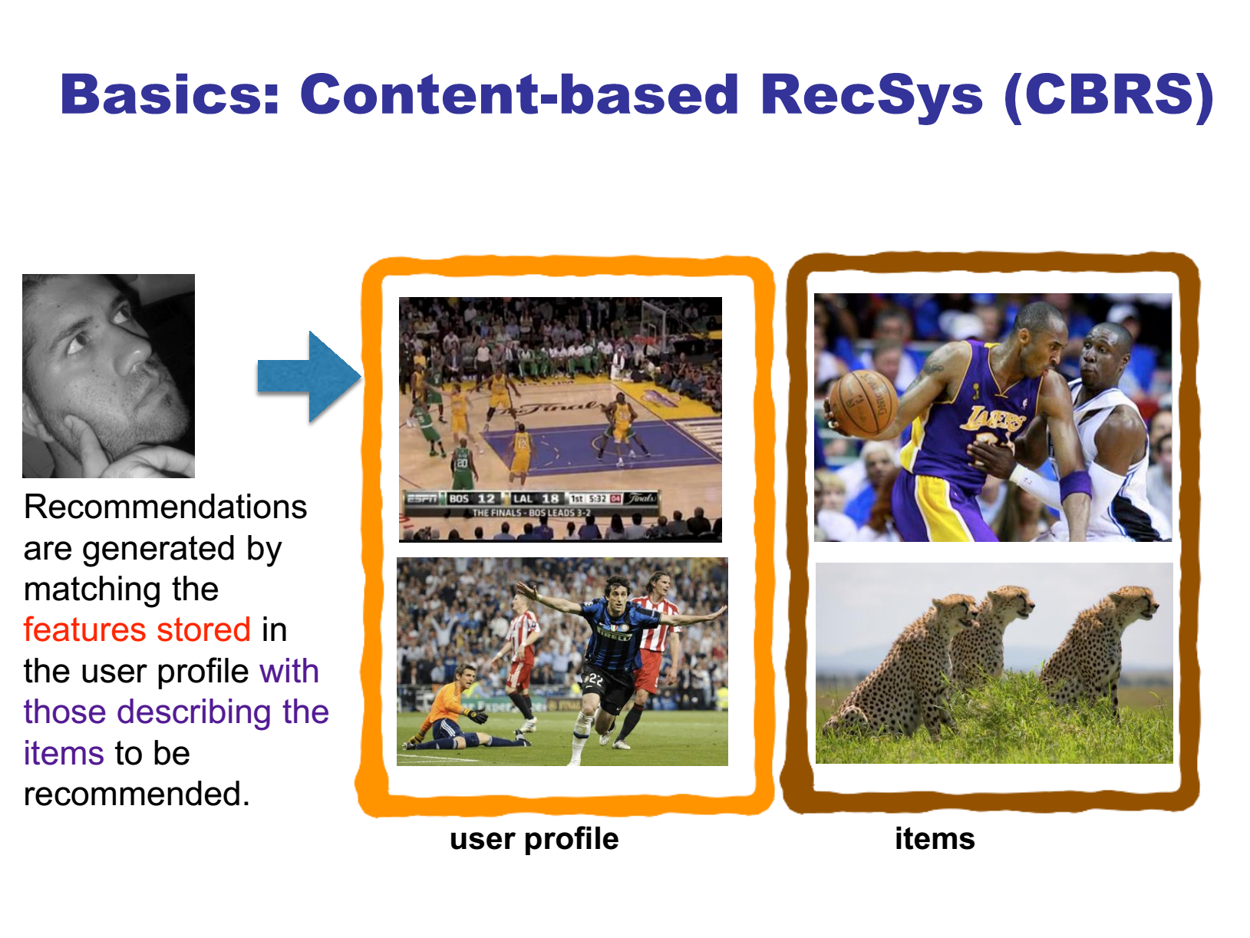

Slide 13
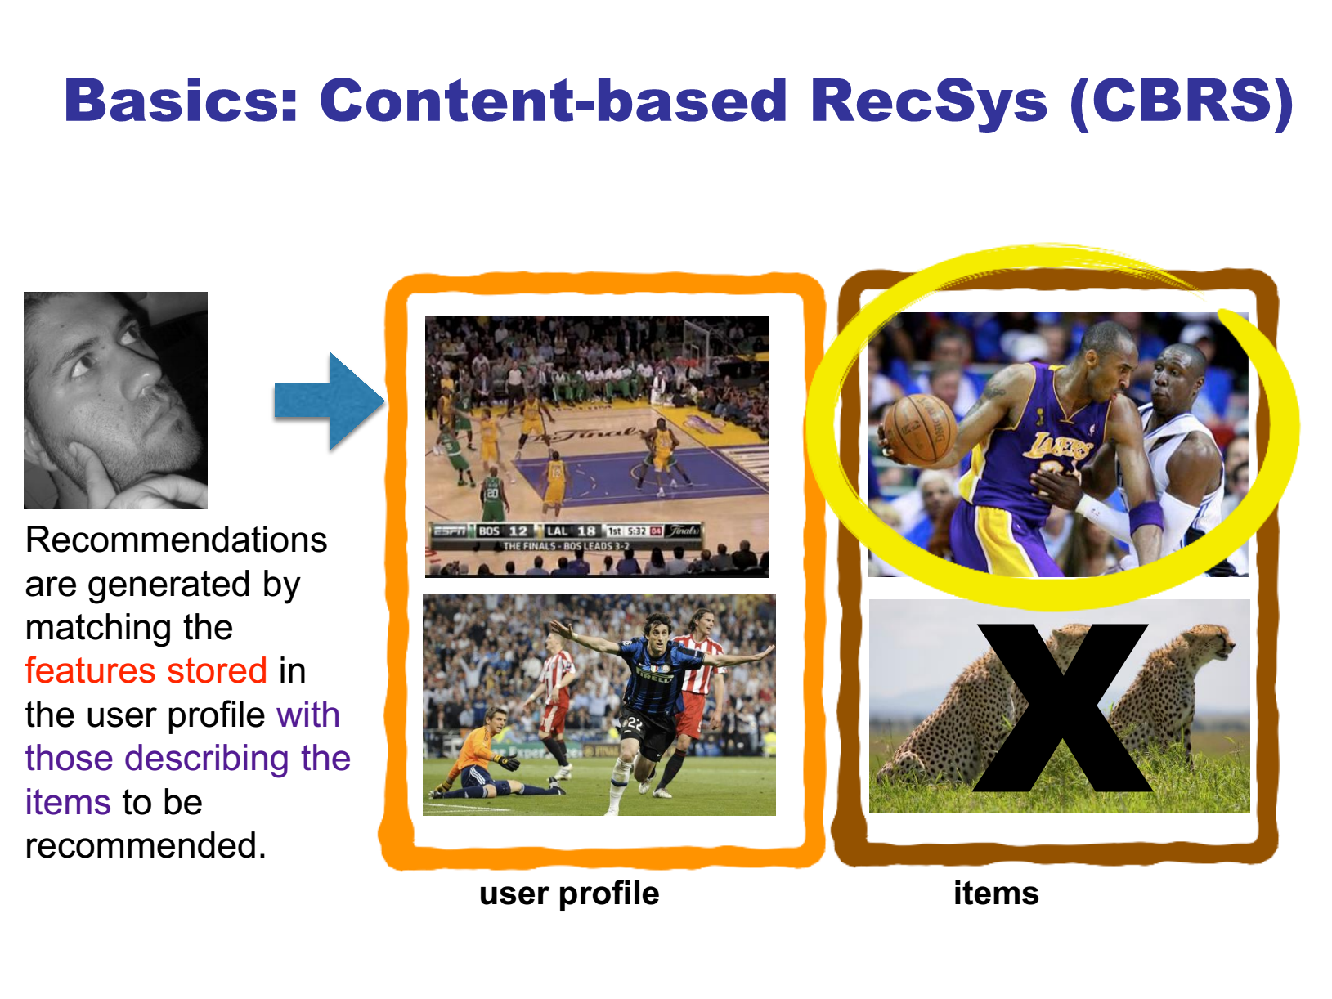

Slide 14
Content-based Recommendation
Suitable for text-based products (web pages, books)
Items are “described” by their features (e.g. keywords)
Users are described by the keywords in the items they bought
Recommendations based on the match between the content (item keywords) and user keywords
The user model can also be a classifier (Neural Networks, SVM, Naïve Bayes...)

Slide 15
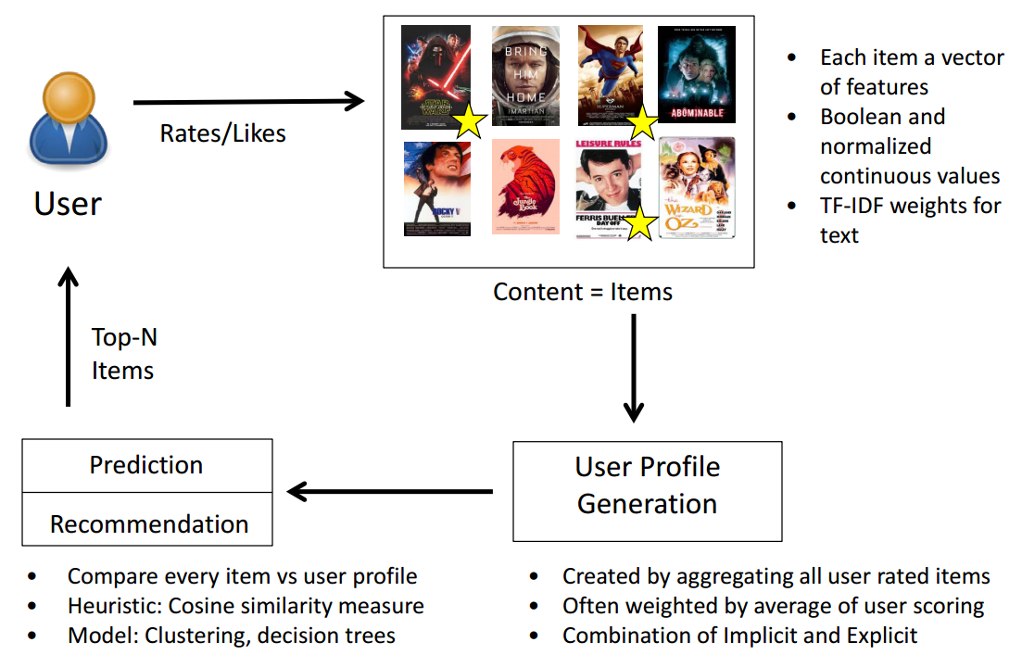
High-level Architecture

Slide 16
Outline
(1) Basic Item Profiling
(2) User Profiling Learning
(3) Item Semantic Representation

Slide 17
Item Profile
For each item, create an item profile
Profile is a set (vector) of features
Movies: author, title, actor, director,…
Text: set of “important” words in document
Q: How to select important features?

Slide 18
Item Representation
Content of items can be represented as
Structured data:
A small number of attributes
Each item is described by the same set of attributes
Known set of values that each attribute may have
Title | Genre | Author | Type | Price | Keywords
The Night of the Gun | Memoir | David Carr | Paperback | 29.90 | Press and journalism, drug addiction, personal memoirs
The Lace Reader | Fiction, Mystery | Brunonia Barry | Hardcover | 49.90 | American contemporary fiction, detective, historical
Into the Fire | Romance, Suspense | Suzanne Brockmann | Hardcover | 45.90 | American fiction, murder, neo-Nazism
Notes:
Convert it to a small vector

Slide 19
Item Representation (2)
Content of items can be represented as
Unstructured data: information about items could be free text
No attribute names with well-defined values
Natural language complexity
Same word with different meanings
Different words with same meaning
E.g., review of restaurants, news articles
Need to impose structure on free text before it can be used for recommendation algorithms.

Slide 20
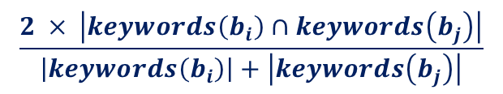
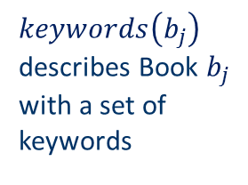
Structured Data
Item representation
Title | Genre | Author | Type | Price | Keywords
The Night of the Gun | Memoir | David Carr | Paperback | 29.90 | Press and journalism, drug addiction, personal memoirs, New York
The Lace Reader | Fiction, Mystery | Brunonia Barry | Hardcover | 49.90 | American contemporary fiction, detective, historical
Into the Fire | Romance, Suspense | Suzanne Brockmann | Hardcover | 45.90 | American fiction, murder, neo-Nazism
User profile
Title | Genre | Author | Type | Price | Keywords
… | Fiction | Brunonia, Barry, Ken Follett | Paperback | 25.65 | Detective, murder, New York
$keywords\left(b_{j}\right)$ describes Book $b_{j}$ with a set of keywords
Simple approach
Compute the similarity of an unseen item with the user profile based on the keyword overlap (e.g. using the Dice coefficient)
Or use and combine multiple metrics
$$\frac{2 × \left|keywords\left(\left.b_{i}\right)\right.∩keywords\left(b_{j}\right)\right|}{\left|keywords\left(\left.b_{i}\right)\right.\right|+\left|keywords\left(\left.b_{j}\right)\right.\right|}$$
Notes:
Dice coefficient s = 2 |X \cap Y|/(|X|+|Y|) is a string similarity measure.
e.g., night vs. nacht (in Germany)
Bigram: {ni, ig, gh, ht} vs. {na, ac, ch, ht}, s = 2*1/(4+4)=2/8=0.25;

Slide 21
Unstructured Data
Standard measure: TF-IDF
Encodes text documents in multi-dimensional Euclidian space
weighted term vector
TF: Measures, how often a term appears (density in a document)
assuming that important terms appear more often
normalization has to be done in order to take document length into account
IDF: Aims to reduce the weight of terms that appear in all documents (how few documents contain the term)
Notes:
idf depends on rarity of a term in a collection. tf-idf increases with the number of occurrences within a document, and with the rarity of the term in the collection.

Slide 22
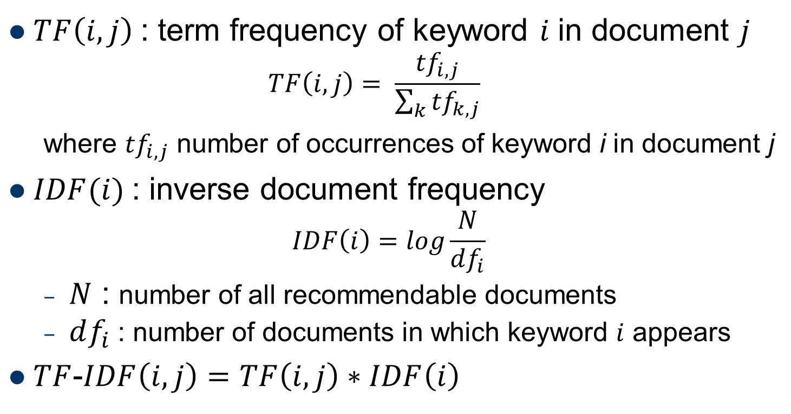
TF-IDF
$TF\left(i,j\right)$: term frequency of keyword $i$ in document $j$
$$TF\left(i,j\right)= \frac{{tf}_{i,j}}{\sum_{k}{{tf}_{k, j}}}$$
where ${tf}_{i,j}$ number of occurrences of keyword i in document j
$IDF(i)$: inverse document frequency
$$IDF\left(i\right)=log\frac{N}{df_{i}}$$
$N$ : number of all recommendable documents
$df_{i}$: number of documents in which keyword $i$ appears
$TF$-$IDF\left(i,j\right)=TF\left(i,j\right)∗IDF\left(i\right)$
Doc profile = set of words with highest TF-IDF scores,
together with their scores

Slide 23
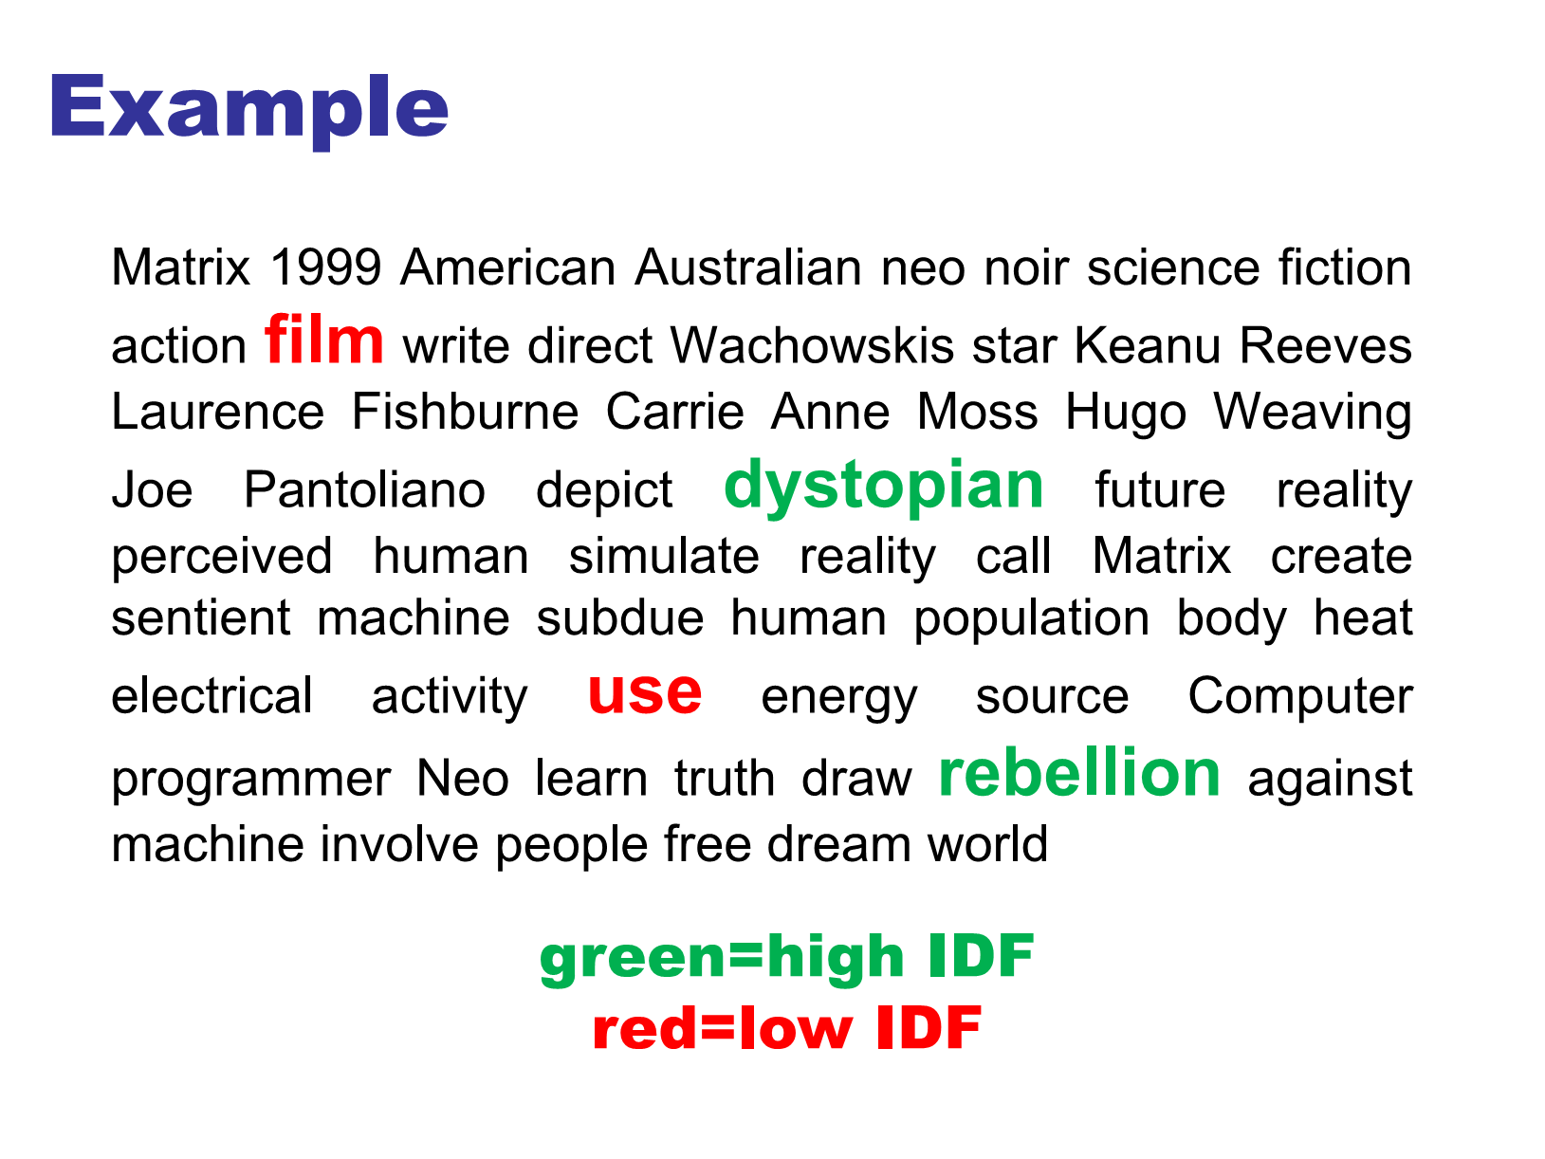

Slide 24
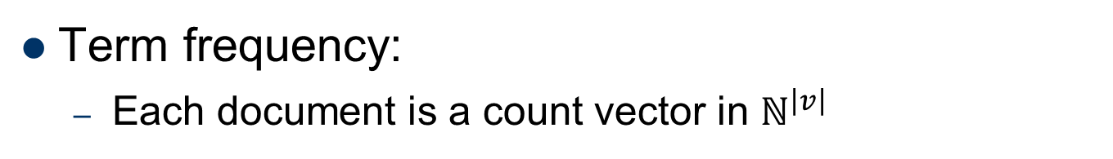
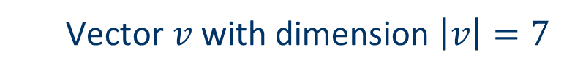
TF-IDF example
Term frequency:
Each document is a count vector in $ℕ^{\left|v\right|}$
 | Antony and Cleopatra | Julius Caesar | The Tempest | Hamlet | Othello | Macbeth
Antony | 157 | 73 | 0 | 0 | 0 | 0
Brutus | 4 | 157 | 0 | 1 | 0 | 0
Caesar | 232 | 227 | 0 | 2 | 1 | 1
Calpurnia | 0 | 10 | 0 | 0 | 0 | 0
Cleopatra | 57 | 0 | 0 | 0 | 0 | 0
mercy | 1.51 | 0 | 3 | 5 | 5 | 1
worser | 1.37 | 0 | 1 | 1 | 1 | 0
Vector $v$with dimension $\left|v\right|=7$
Example taken from http://informationretrieval.org

Slide 25
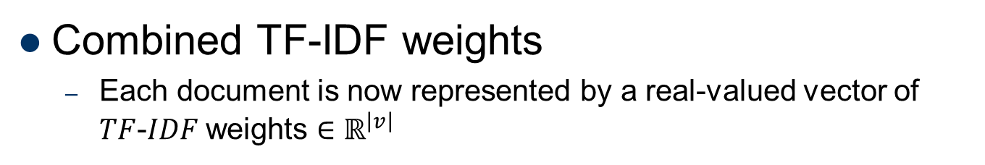
TF-IDF example (2)
Combined TF-IDF weights
Each document is now represented by a real-valued vector of $TF$-$IDF$weights $∈ℝ^{\left|v\right|}$
 | Antony and Cleopatra | Julius Caesar | The Tempest | Hamlet | Othello | Macbeth
Antony | 157 | 73 | 0 | 0 | 0 | 0
Brutus | 4 | 157 | 0 | 1 | 0 | 0
Caesar | 232 | 227 | 0 | 2 | 1 | 1
Calpurnia | 0 | 10 | 0 | 0 | 0 | 0
Cleopatra | 57 | 0 | 0 | 0 | 0 | 0
mercy | 1.51 | 0 | 3 | 5 | 5 | 1
worser | 1.37 | 0 | 1 | 1 | 1 | 0
 | Antony and Cleopatra | Julius Caesar | The Tempest | Hamlet | Othello | Macbeth
Antony | 5.25 | 3.18 | 0 | 0 | 0 | 0.35
Brutus | 1.21 | 6.1 | 0 | 1 | 0 | 0
Caesar | 8.59 | 2.54 | 0 | 1.51 | 0.25 | 0
Calpurnia | 0 | 1.54 | 0 | 0 | 0 | 0
Cleopatra | 2.85 | 0 | 0 | 0 | 0 | 0
mercy | 1.51 | 0 | 1.9 | 0.12 | 5.25 | 0.88
worser | 1.37 | 0 | 0.11 | 4.15 | 0.25 | 1.95
Example taken from http://informationretrieval.org

Slide 26
Improving vector representation
remove stop words
They will appear in nearly all documents, "the", "on"…
http://www.ranks.nl/stopwords
Default (English/MySQL/Google/…) stopwords list
use stemming
Aims to replace variants of words by their common stem
e.g. "went" "go", "stemming" "stem", …
size cut-offs
only use top n most representative words to remove "noise" from data, e.g. use top 100 words
Detection of phrases as terms
More descriptive for a text than single words, e.g. "United Nations"

Slide 27
Improving vector representation (2)
Use lexical knowledge, use more elaborate methods for feature selection
Remove words that are not relevant in the domain
Limitations
This method does not capture the context in which a word is used
Example: usage of a word in a negative context
"there is nothing on the menu that a vegetarian would like.."
The word "vegetarian" will receive a higher weight then desired
an unintended match with a user interested in vegetarian restaurants
Notes:
The term “vegetarian” might still have significant weight according to the method and the restaurant might get classified into a group of restaurants which serve vegetarian food.

Slide 28
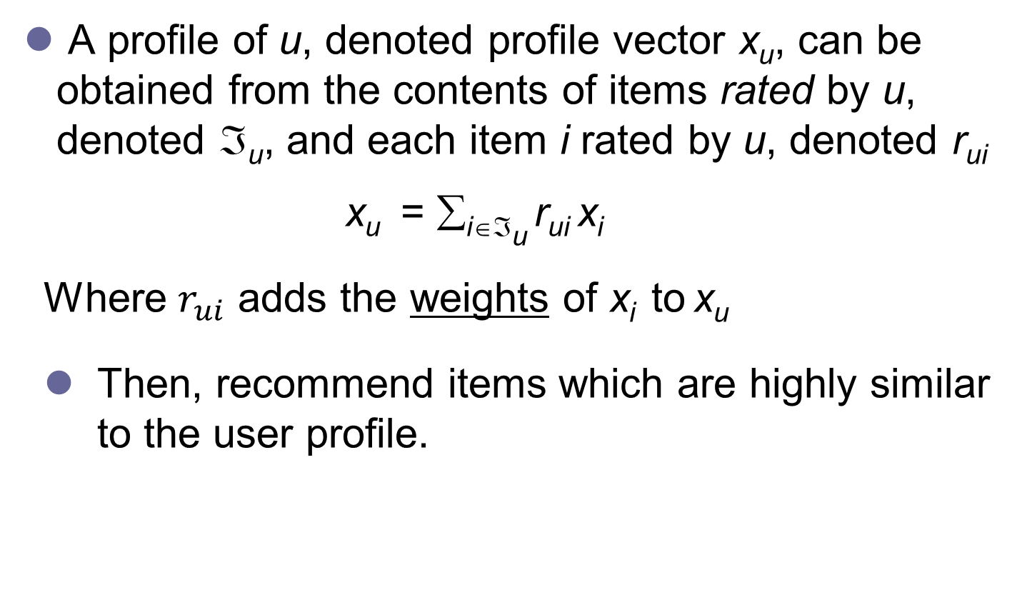
User Profile by KNN
A profile of u, denoted profile vector x_{u}, can be obtained from the contents of items rated by u, denoted ℑ_{u}, and each item i rated by u, denoted r_{ui}
x_{u} = ∑_{i∈ℑu} r_{ui} x_{i}
Where $r_{ui}$ adds the weights of x_{i} to x_{u}
Then, recommend items which are highly similar to the user profile.

Slide 29
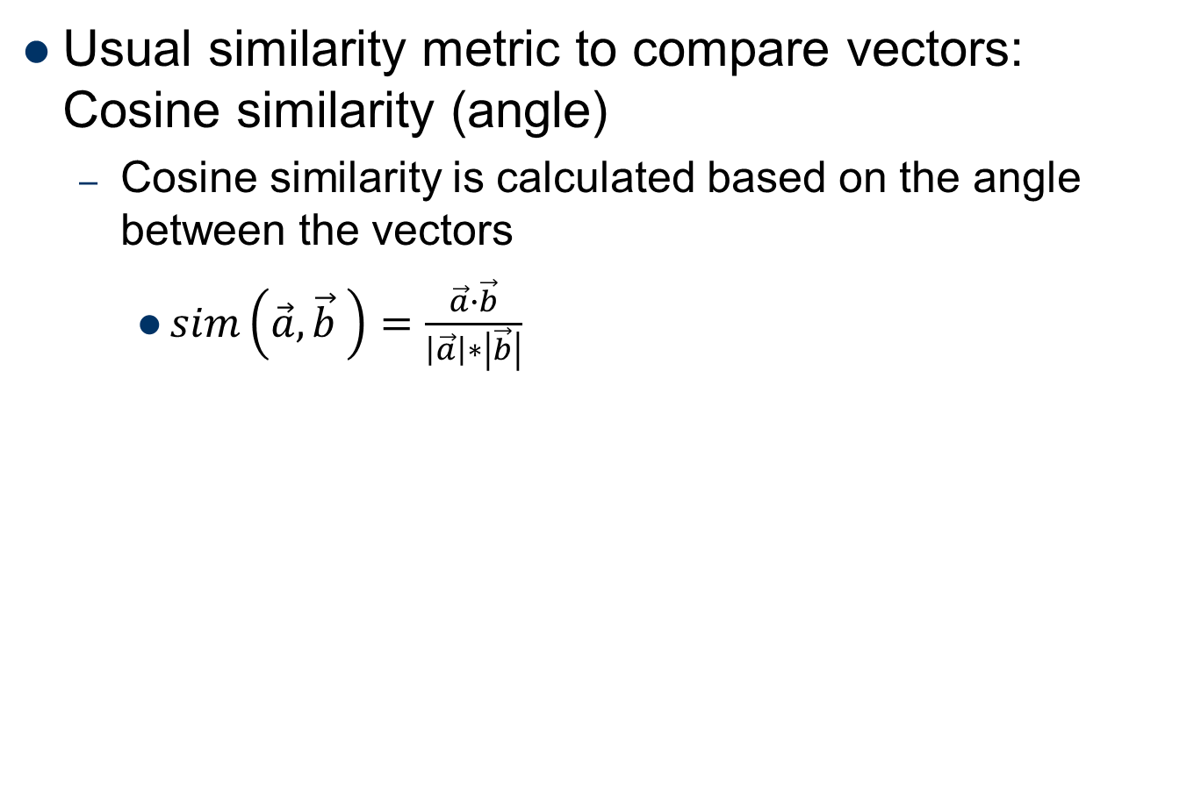
Cosine similarity
Usual similarity metric to compare vectors: Cosine similarity (angle)
Cosine similarity is calculated based on the angle between the vectors
$sim\left(\vec{a},\vec{b} \right)=\frac{\vec{a}∙\vec{b}}{\left|\vec{a}\right|∗\left|\vec{b}\right|}$

Slide 30
Outline
(1) Basic Item Profiling
(2) User Profiling Learning
(3) Item Semantic Representation
Notes:
Predict user preference from a user’s perspective, i.e., by directly generating user profile from explicit information or user data.

Slide 31
User Profiling
User profile: a profile of the user’s interest is used by most recommender systems
This profile consists of two main types of information
A model of the user’s preferences, e.g., a function that (for any item) predicts the likelihood that the user is interested in that item
User’s interaction history, e.g., items viewed by a user, items purchased by a user, search queries, etc.
can be used as training data for a machine learning algorithm that creates a user model

Slide 32
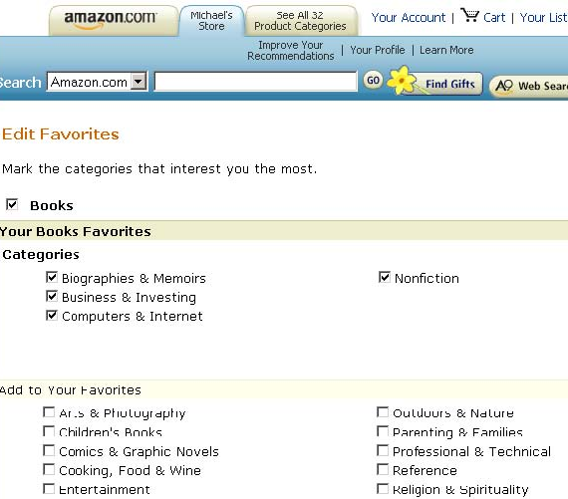
Manual User Profiling
“manual” recommendation by user customization
Provide “check box” interface that lets the users construct their own profiles of interests
A simple database matching process is used to find items that meet the specified criteria and recommend these to users
Limitations:
Require efforts from users
Cannot cope with changes in user’s interests
Do not provide a way to determine order among recommending items

Slide 33
Manual User Profiling (2)
“manual” recommendation by predefined rules
The system has rules to recommend other products based on user history
Rule to recommend sequel to a book or movie to users who purchased the previous item in the series
Can capture common reasons for making recommendations

Slide 34
课堂思辨：冷启动用户的解决办法？
什么是冷启动用户？
你见过哪些解决办法？对推荐结果是否满意？
你觉得还有哪些解决办法？

Slide 35
Profile Learning
Creating a model of the user’s preference from the user history is a form of classification learning
Input (X): an item’s profile (i.e., a set of features)
Output (Y): whether a user likes the item
Objective: to learn a classification function f such that Y = f(X), then we can predict if a user will like a given item or not
Then, a number of classification learning algorithms can be used and reviewed

Slide 36
Profile Learning Outline
K-Nearest Neighbors (KNN)
Rocchio Algorithm
Decision Tree
Linear Classifier
Naïve Bayes

Slide 37
Nearest Neighbor Methods
Simple store all the training data in memory
To classify a new item, compare it to all stored items using a similarity measure and determine the top-K “nearest neighbors”
The class or numeric score of the previously unseen item can then be derived from the class or score of the nearest neighbors

Slide 38
Euclidean Distance Metric
Item | Attr. X | Attr. Y | Attr. Z
A | X_{A} | Y_{A} | Z_{A}
B | X_{B} | Y_{B} | Z_{B}
Distance between A and B
Attributes which are not measured quantitatively need to be labeled by numbers representing their categories
Cuisine attribute: 1=French, 2=Italian, 3=Mexican.

Slide 39
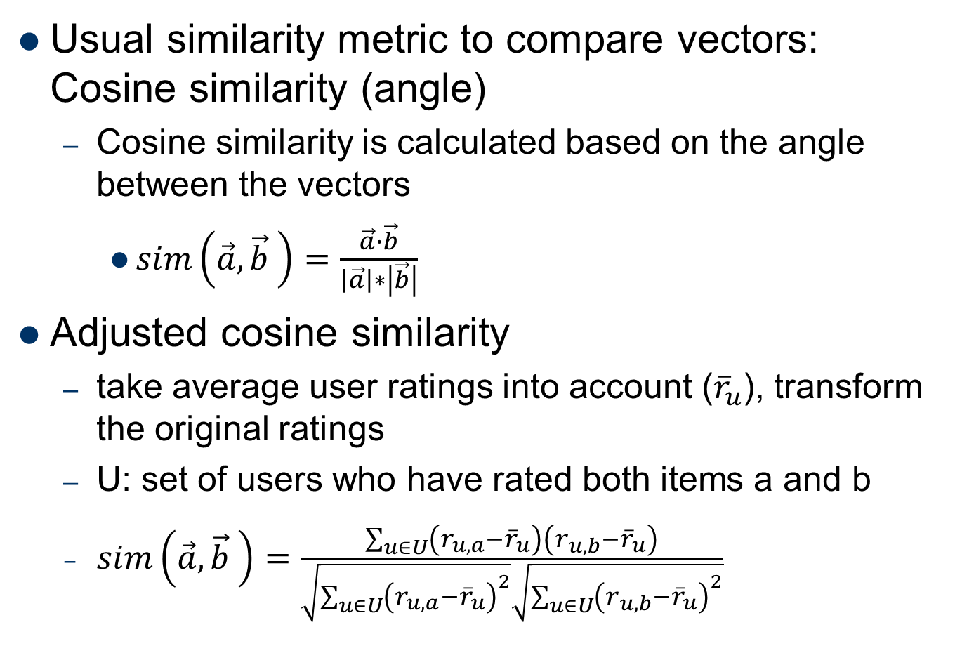
Cosine similarity
Usual similarity metric to compare vectors: Cosine similarity (angle)
Cosine similarity is calculated based on the angle between the vectors
$sim\left(\vec{a},\vec{b} \right)=\frac{\vec{a}∙\vec{b}}{\left|\vec{a}\right|∗\left|\vec{b}\right|}$
Adjusted cosine similarity
take average user ratings into account (${\overline{r}}_{u}$), transform the original ratings
U: set of users who have rated both items a and b
$sim\left(\vec{a},\vec{b} \right)=\frac{\sum_{u∈U}{\left(r_{u,a}−{\overline{r}}_{u}\right)}\left(r_{u,b}−{\overline{r}}_{u}\right)}{\sqrt{\sum_{u∈U}{{\left(r_{u,a}−{\overline{r}}_{u}\right)}^{2}}}\sqrt{\sum_{u∈U}{{\left(r_{u,b}−{\overline{r}}_{u}\right)}^{2}}}}$

Slide 40

Nearest Neighbor Methods (2)
unseen item needed to be classified
positive rated items
negative rated items
k = 3: negative
k = 5: positive
The similarity measure depends on the type of data:
Structured data: Euclidean distance metric
Unstructured data: cosine similarity measure

Slide 41
Nearest Neighbour Methods
Despite the simplicity of the algorithm, its performance has been shown to be competitive with more complex algorithms

Slide 42
Profile Learning Outline
K-Nearest Neighbors (KNN)
Rocchio’s Algorithm
Decision Tree
Linear Classifier
Naïve Bayes

Slide 43
Ricchio’s Algorithm
Retrieval quality depends on individual capability to formulate queries with right keywords.
Query-based retrieval: Rocchio's method
The SMART System: Users are allowed to rate (relevant/irrelevant) retrieved documents (feedback)
The system then learns a prototype of relevant/irrelevant documents
Queries are then automatically extended with additional terms/weight of relevant documents

Slide 44
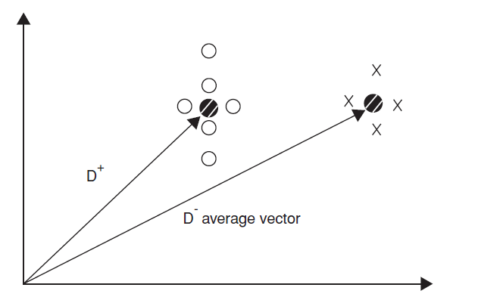
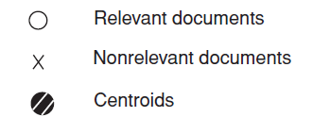
Rocchio details
Document collections D⁺ (liked) and D⁻ (disliked)
Calculate prototype vector for these categories.

Slide 45
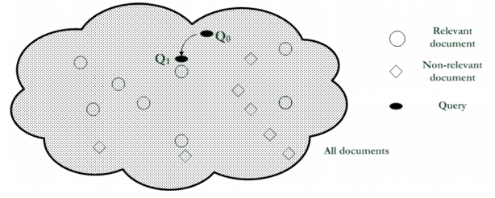
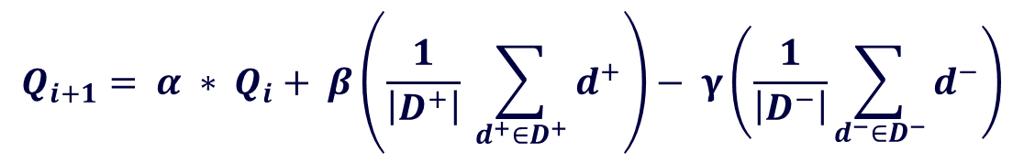
Rocchio details (2)
Computing modified query Qi+1 from current query Qi with:
$$Q_{i+1}= α ∗ Q_{i}+ β\left(\frac{1}{\left|D^{+}\right|} \sum_{d^{+}∈D^{+}}{d^{+}}\right)− γ\left(\frac{1}{\left|D^{−}\right|}\sum_{d^{−}∈D^{−}}{d^{−}}\right)$$
α, β, γ used to fine-tune the feedback
α weight for original query
β weight for positive feedback
γ weight for negative feedback
Often only positive feedback is used
More valuable than negative feedback

Slide 46
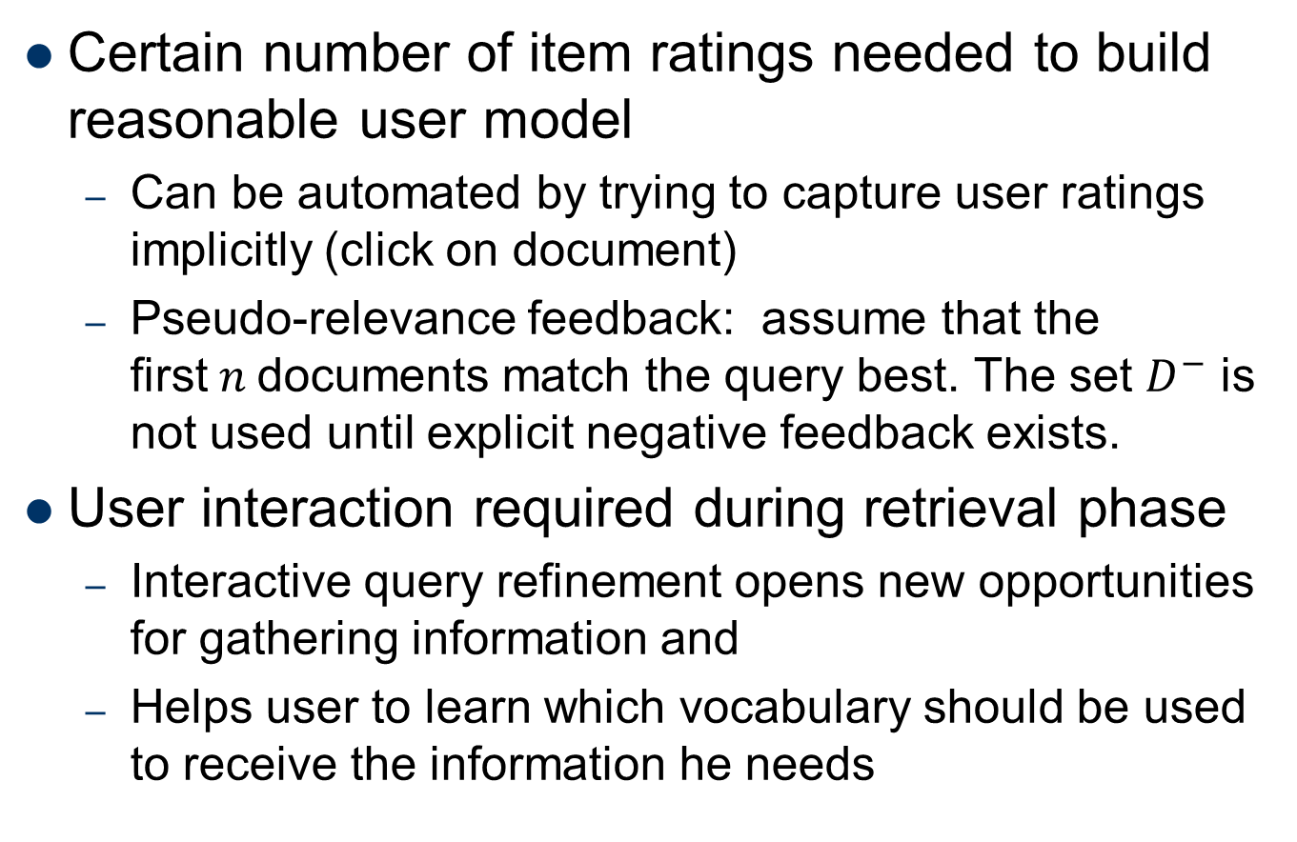
Practical challenges of Rocchio's method
Certain number of item ratings needed to build reasonable user model
Can be automated by trying to capture user ratings implicitly (click on document)
Pseudo-relevance feedback: assume that the first$n$documents match the query best. The set $D^{−}$ is not used until explicit negative feedback exists.
User interaction required during retrieval phase
Interactive query refinement opens new opportunities for gathering information and
Helps user to learn which vocabulary should be used to receive the information he needs

Slide 47
Profile Learning Outline
K-Nearest Neighbors (KNN)
Rocchio’s Algorithm
Decision Tree
Linear Classifier
Naïve Bayes

Slide 48
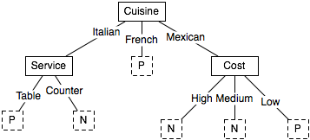
Decision Tree
Given the history of user’s interests as training data, building a decision tree which represents the user’s profile of interest
Will the user like an inexpensive Mexican restaurant?
Cuisine | Service | Cost | Rating
Italian | Counter | Low | Negative
French | Table | Med | Positive
French | Counter | Low | Positive
… | … | … | …

Slide 49
Decision Tree (2)
Decision tree for recommendation problems
inner nodes labeled with item features (keywords)
used to partition the test examples
existence or non existence of a keyword
in basic setting only two classes appear at leaf nodes
interesting or not interesting
decision tree can automatically be constructed from training data
works best with small number of features
use meta features like author name, genre, ... instead of TF-IDF representation.

Slide 50
Rule Induction
Rule induction
built on RIPPER algorithm
good performance compared with other classification methods
elaborate postpruning techniques of RIPPER
extension for e-mail classification
takes document structure into account
Main advantages
inferred decision rules serve as basis for generating explanations for recommendation
existing domain knowledge can be incorporated in models
Notes:
RIPPER is a rule induction algorithm closely related to decision trees that operates in a similar fashion to the recursive data partitioning approach described above. Despite the problematic inductive bias, however, RIPPER performs competitively with other state-of-the-art text classification algorithms. In part, the performance can be attributed to a sophisticated post-pruning algorithm that optimizes the fit of the induced rule set with respect to the training data as a whole. Furthermore, RIPPER supports multi-valued attributes, which leads to a natural representation for text classification tasks, i.e., the individual words of a text document can be represented as multiple feature values for a single feature. While this is essentially a representational convenience if rules are to be learned from unstructured text documents, the approach can lead to more powerful classifiers for semi-structured text documents. For example, the text contained in separate fields of an email message, such as sender, subject, and body text, can be represented as separate multi-valued features, which allows the algorithm to take advantage of the document’s structure in a natural fashion.

Slide 51
Decision Tress (3)
Well-suited for structured data
For unstructured data, the number of attributes becomes too enormous and consequently, the tree becomes too large to provide sufficient performance.

Slide 52
Profile Learning Outline
K-Nearest Neighbors (KNN)
Rocchio’s Algorithm
Decision Tree
Linear Classifier
Naïve Bayes

Slide 53
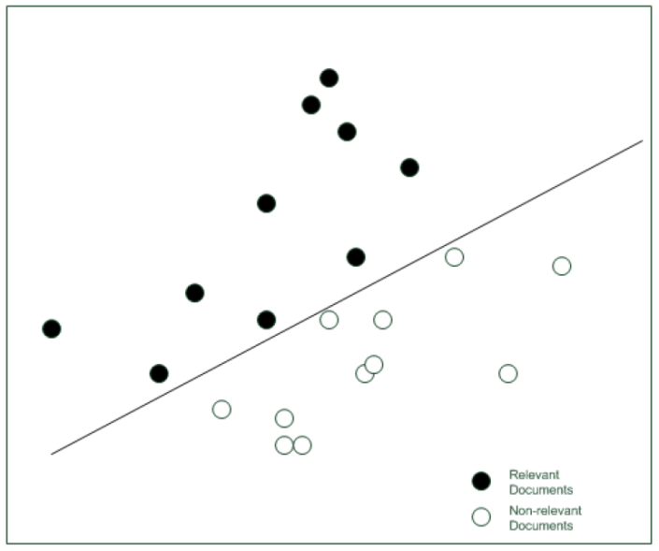
Linear classifiers
Most learning methods aim to find coefficients of a linear model
A simplified classifier with only two dimensions can be represented by a line

Slide 54
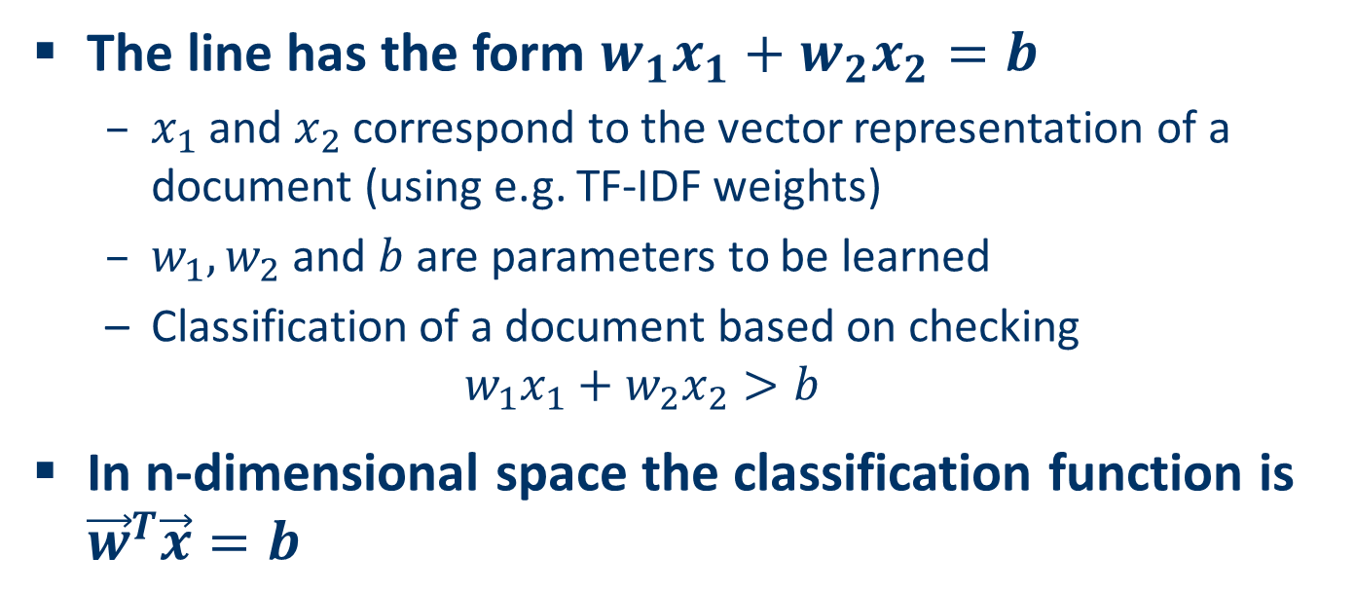
Linear classifiers (2)
The line has the form $w_{1}x_{1}+w_{2}x_{2}=b$
$x_{1}$ and $x_{2}$correspond to the vector representation of a document (using e.g. TF-IDF weights)
$w_{1},w_{2}$ and $b$ are parameters to be learned
Classification of a document based on checking $w_{1}x_{1}+w_{2}x_{2}>b$
In n-dimensional space the classification function is ${\vec{w}}^{T}\vec{x}=b$

Slide 55
Pros: content-based filtering
No need for data on other users
No cold-start or sparsity problems
Can recommend to users with unique tastes
Can recommend new & unpopular items
No first-rater problem
Can provide explanations
Can provide explanations of recommended items by listing content-features that caused an item to be recommended

Slide 56
Cons: content-based filtering
Finding appropriate features is hard because:
content may be limited / too short
content may not be automatically extractable
manual feature engineering
Cold-start/new users
How to build a user profile?
Overspecialization
Never recommends items beyond user’s content profile
A limited degree of novelty, i.e., serendipity problem
People might have multiple interests
Unable to exploit quality judgments of other users
Notes:
Searching proper features is not easy: image, music.

Slide 57
Outline
(1) Content-based Filtering
(2) User Profiling
(3) Item Semantic Representation
Explicit (Exogenous) Semantics
Implicit (Endogenous) Semantics
Notes:
Exogenous ad. 外源的，外生的；Endogenous adj. 内源的，内生的；

Slide 58
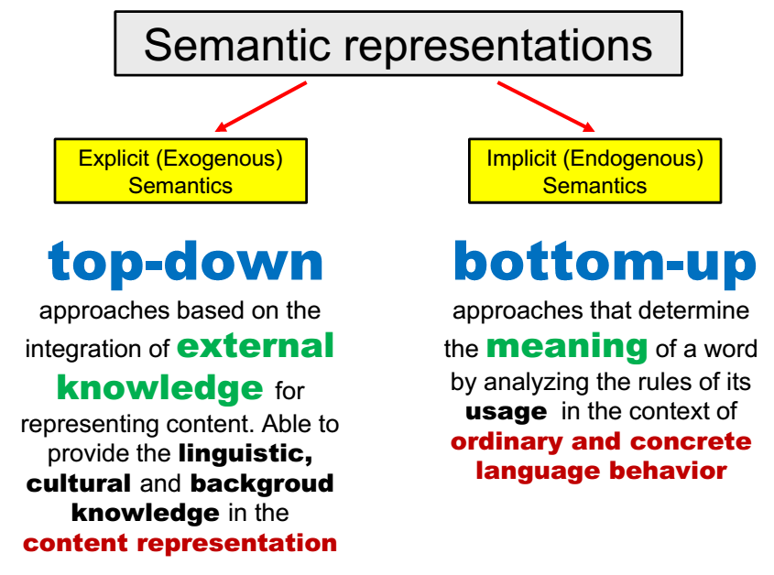

Slide 59
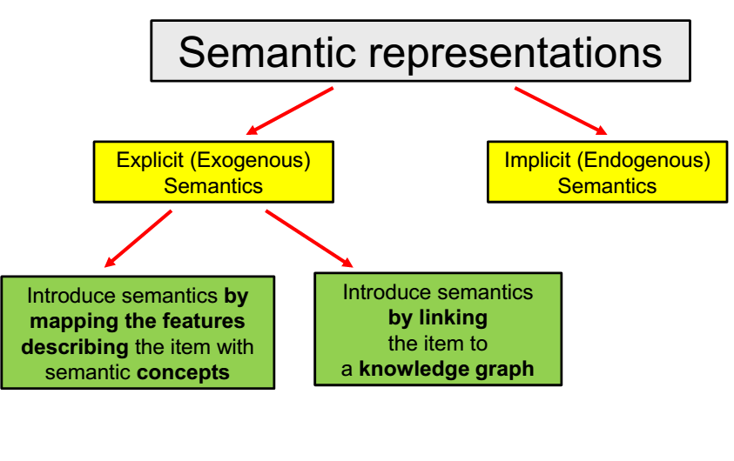

Slide 60
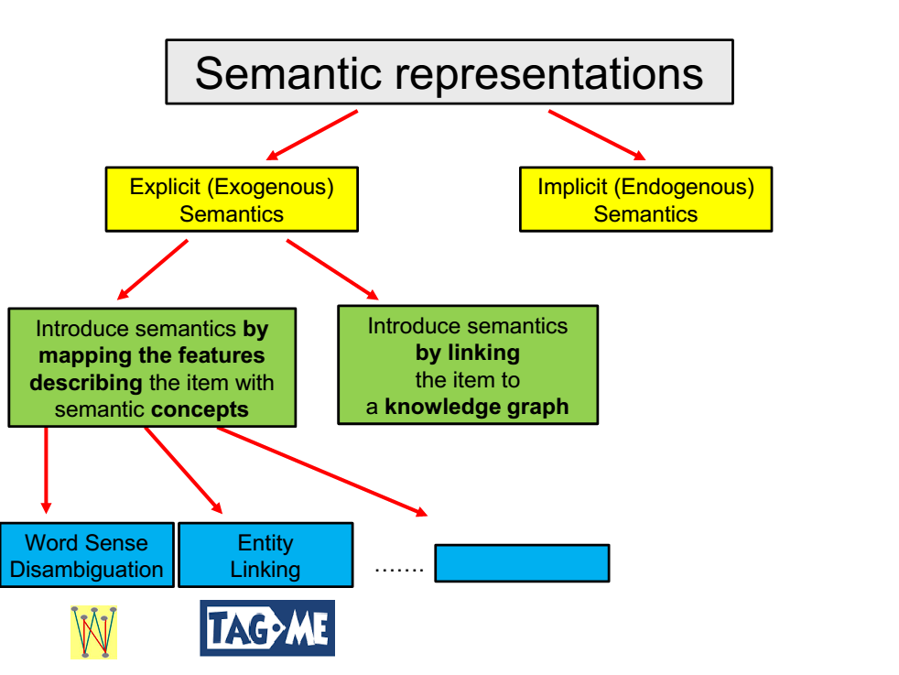

Slide 61
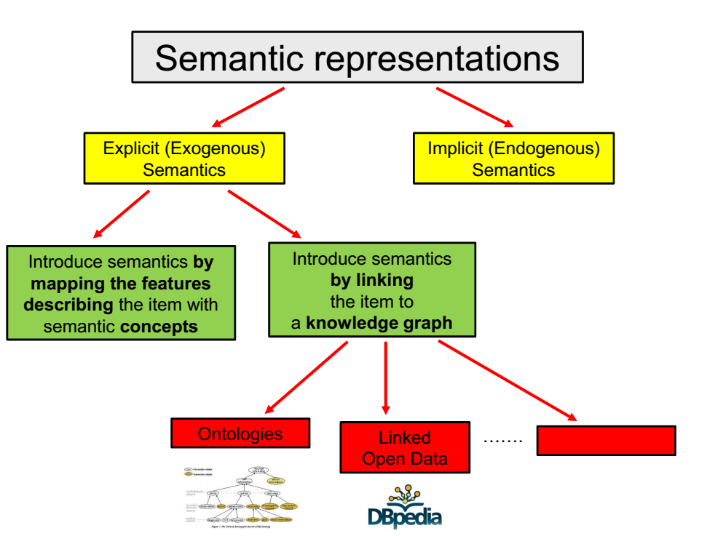

Slide 62
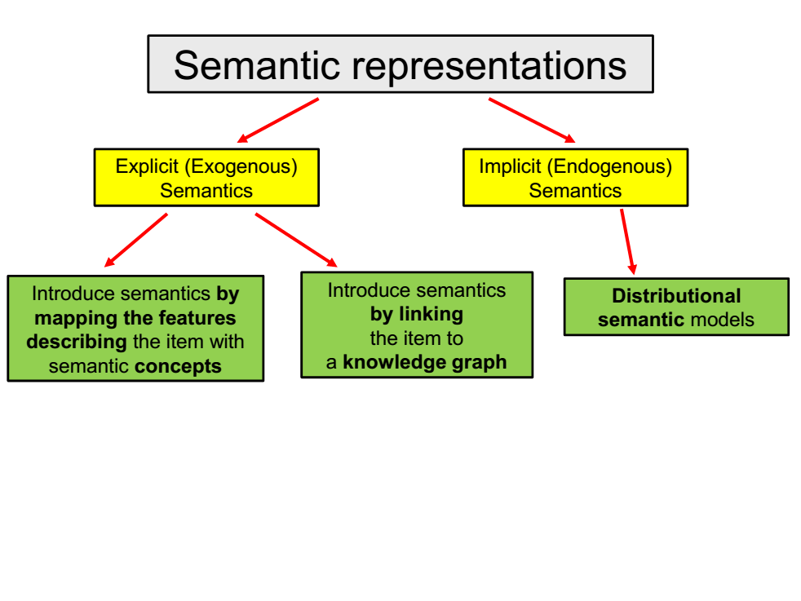

Slide 63
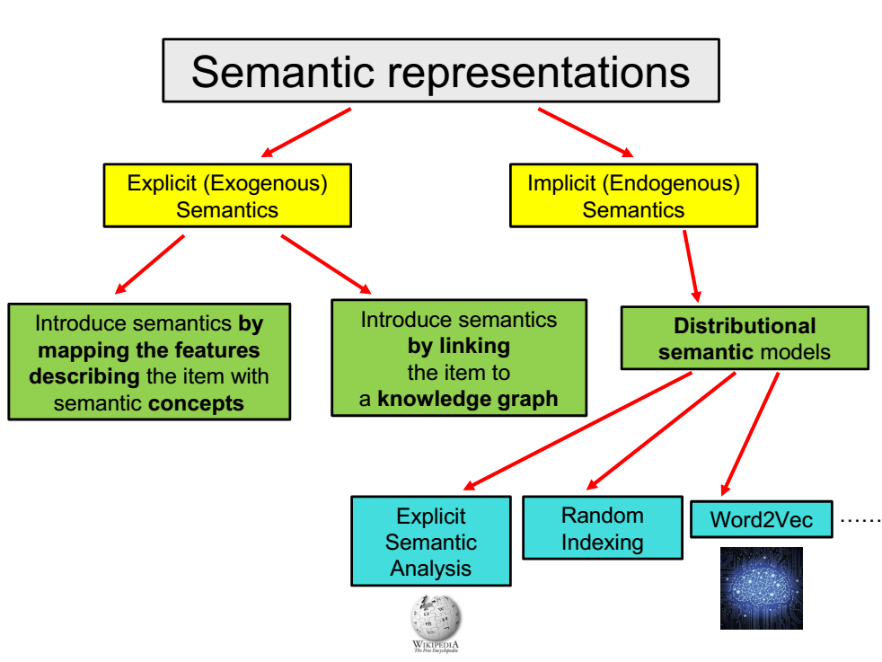

Slide 64
Explicit Semantics
Encoding exogenous semantics

Slide 65
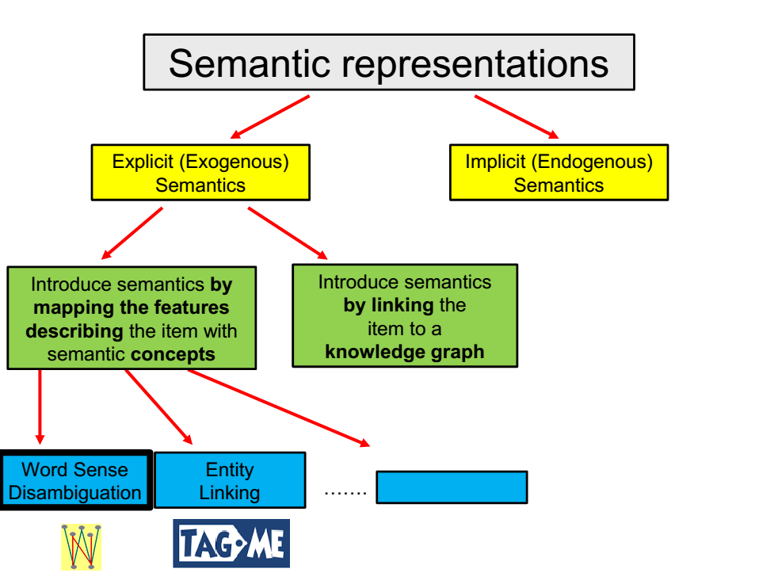

Slide 66
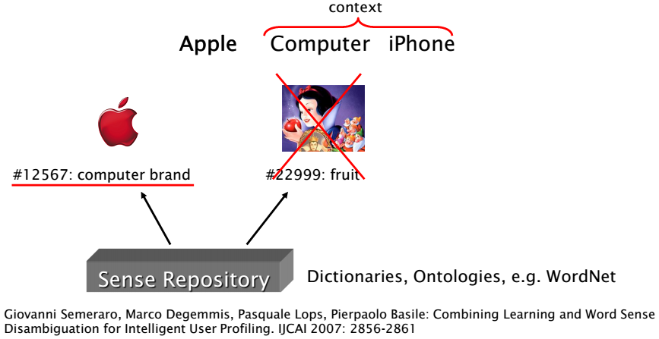
Word Sense Disambiguation (WSD)
WSD selects the proper meaning, i.e. sense, for a word in a text by taking into account the context in which it occurs

Slide 67
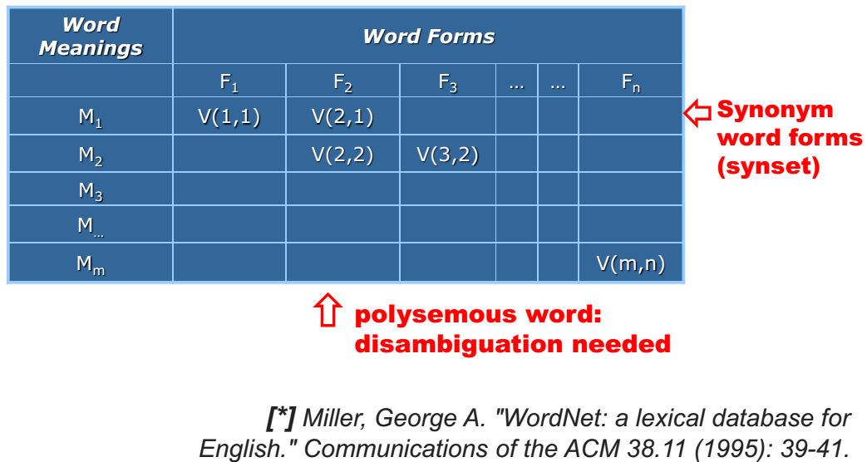
Sense Repository
WordNet linguistic ontology
https://wordnet.princeton.edu/
WordNet groups words into sets of synonyms called synsets. It contains nouns, verbs, adjectives, adverbs

Slide 68
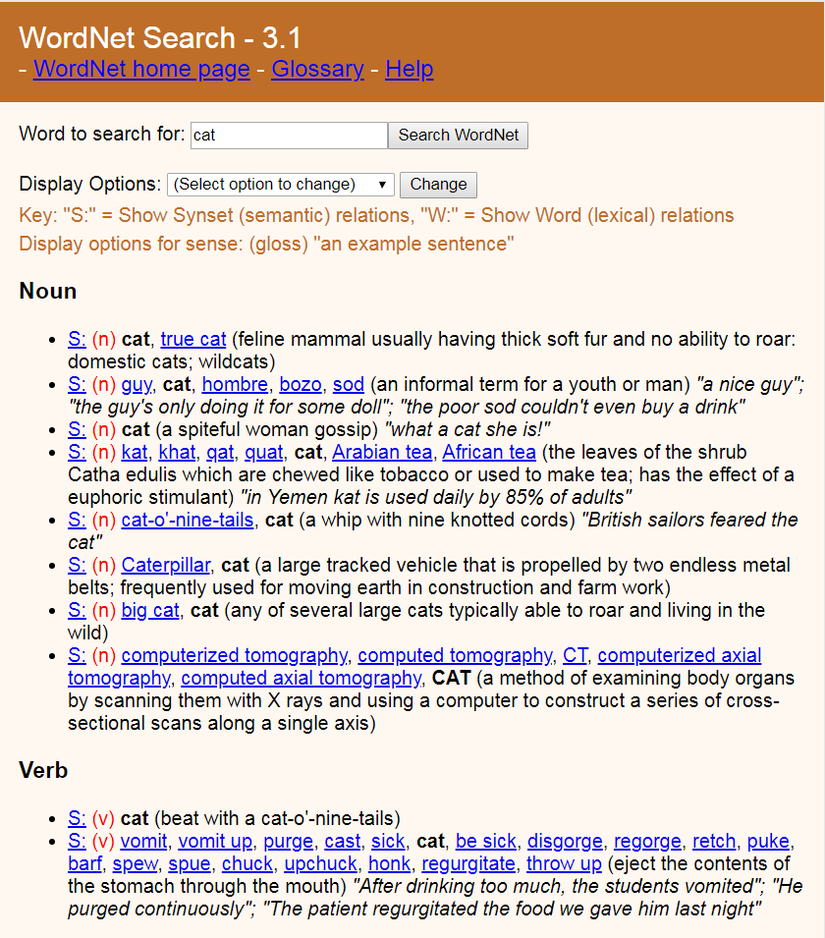
Notes:
An example of synset:
http://wordnetweb.princeton.edu/perl/webwn?s=cat&sub=Search+WordNet&o2=&o0=1&o8=1&o1=1&o7=&o5=&o9=&o6=&o3=&o4=&h=

Slide 69
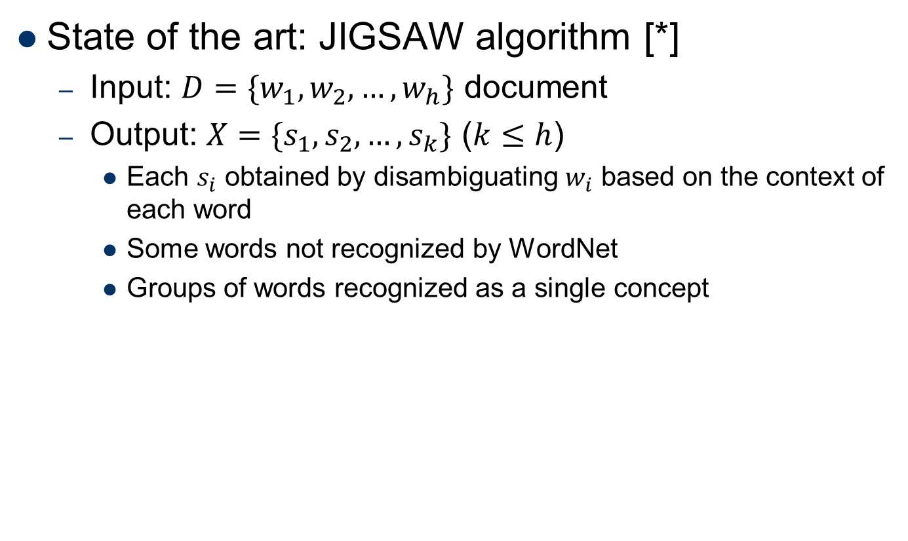
Word Sense Disambiguation
State of the art: JIGSAW algorithm [*]
Input: $D=\{w_{1},w_{2},…,w_{h}\}$ document
Output: $X=\{s_{1},s_{2},…,s_{k}\}$ ($k≤h$)
Each $s_{i}$ obtained by disambiguating $w_{i}$ based on the context of each word
Some words not recognized by WordNet
Groups of words recognized as a single concept
[*] Basile, P., de Gemmis, M., Gentile, A. L., Lops, P., & Semeraro, G. (2007, June). UNIBA:
JIGSAW algorithm for word sense disambiguation. In Proceedings of the 4th International
Workshop on Semantic Evaluations (pp. 398-401). Association for Computational Linguistics.

Slide 70
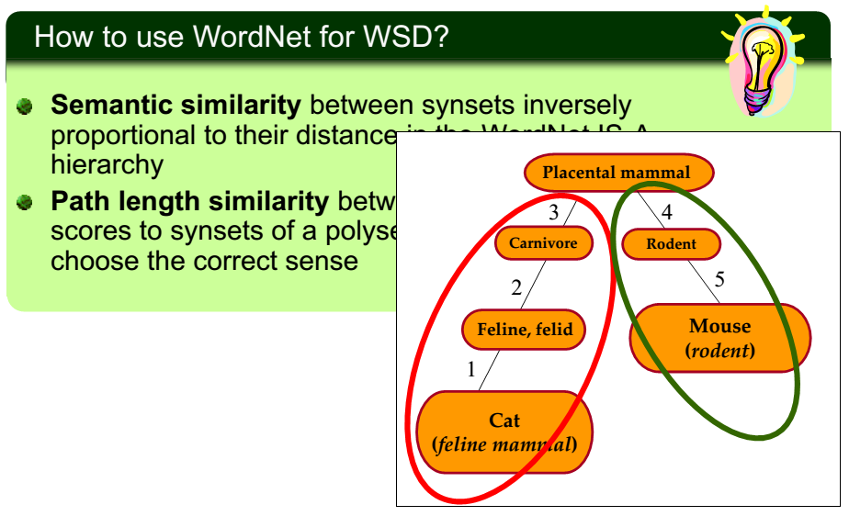
JIGSAW WSD algorithm

Slide 71
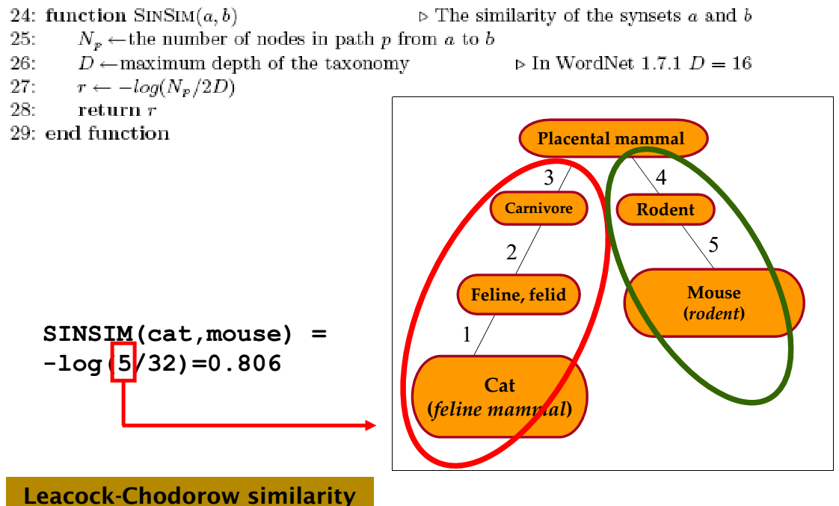
Synset Semantic Similarity

Slide 72
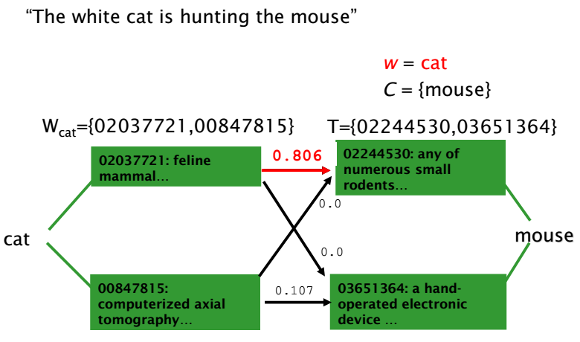
JIGSAW WSD algorithm

Slide 73
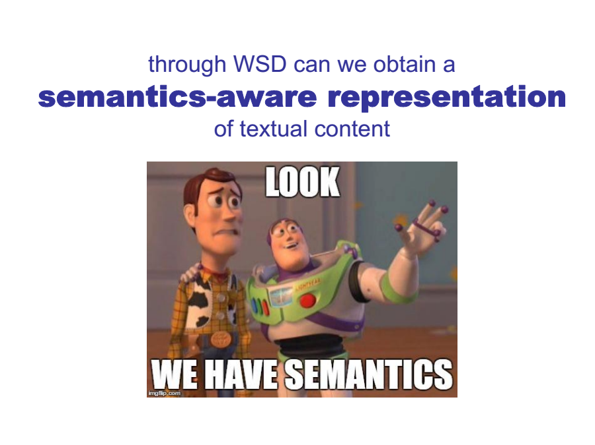

Slide 74
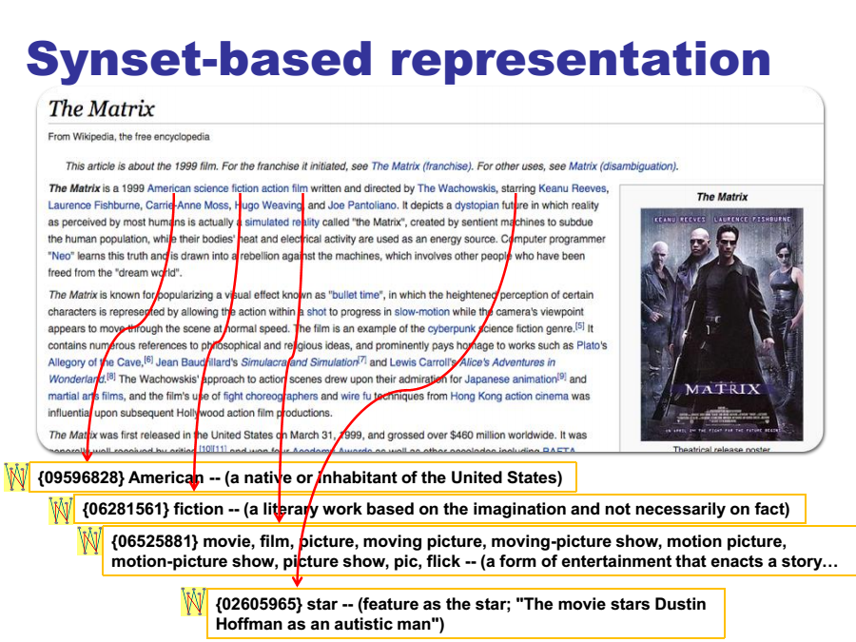

Slide 75
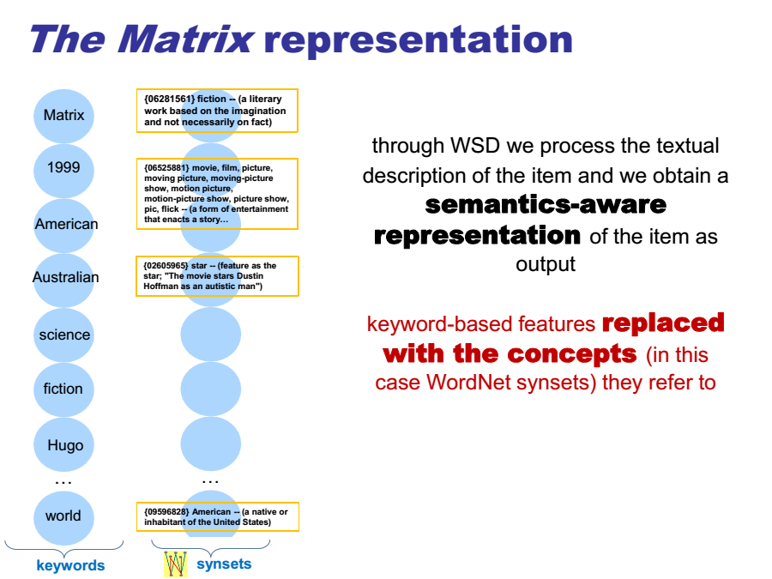

Slide 76
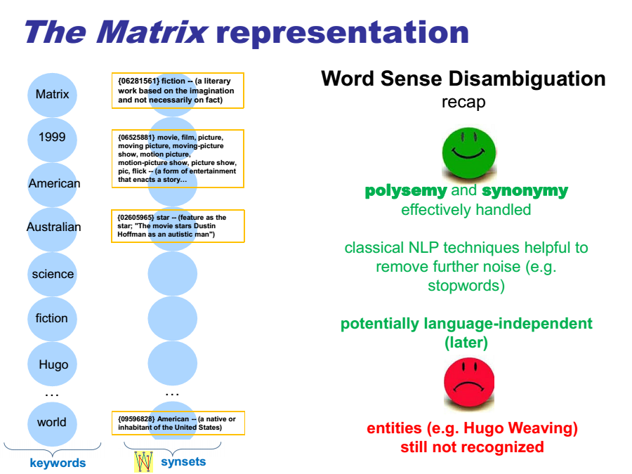

Slide 77
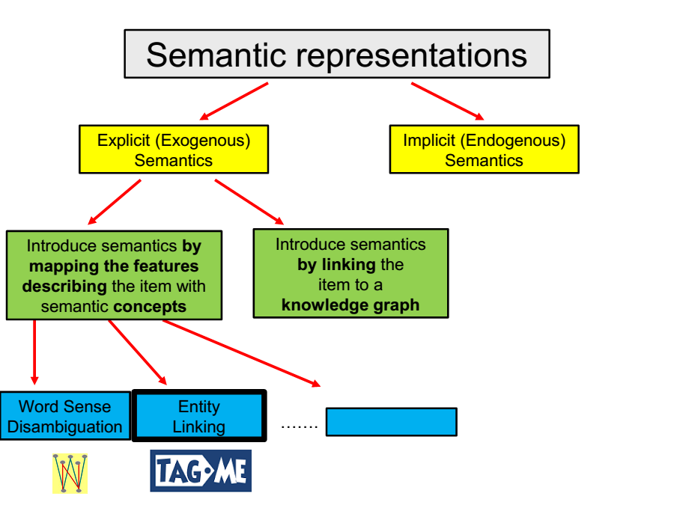

Slide 78

Entity Linking Algorithms
Basic Idea
Input: free text
Output: identification of the entities mentioned in the text.
Available packages:
OpenCalais
Tag.me
Babelfy

Slide 79

OpenCalais
Notes:
http://www.opencalais.com/opencalais-api/

Slide 80


Slide 81


Slide 82

Tag.me
Notes:
https://tagme.d4science.org/tagme/

Slide 83

Tag.me (2)
Notes:
https://tagme.d4science.org/tagme/

Slide 84

Tag.me (3)
Notes:
https://tagme.d4science.org/tagme/

Slide 85

Tag.me (4)
Notes:
https://tagme.d4science.org/tagme/

Slide 86

Tag.me + Wikipedia Categories
Notes:
https://tagme.d4science.org/tagme/

Slide 87

Tag.me + Wikipedia Categories (2)
Notes:
https://tagme.d4science.org/tagme/

Slide 88


Slide 89


Slide 90

Babelfy
Notes:
http://babelfy.org/

Slide 91

Babelfy (2)
Notes:
http://babelfy.org/

Slide 92

Babelfy (3)
Notes:
http://babelfy.org/

Slide 93

Babelfy (4)
Notes:
http://babelfy.org/

Slide 94


Slide 95


Slide 96


Slide 97


Slide 98


Slide 99


Slide 100


Slide 101


Slide 102


Slide 103


Slide 104


Slide 105


Slide 106


Slide 107


Slide 108


Slide 109


Slide 110


Slide 111


Slide 112


Slide 113


Slide 114


Slide 115


Slide 116


Slide 117


Slide 118


Slide 119


Slide 120


Slide 121


Slide 122


Slide 123


Slide 124


Slide 125


Slide 126


Slide 127


Slide 128


Slide 129


Slide 130


Slide 131


Slide 132


Slide 133


Slide 134


Slide 135


Slide 136


Slide 137


Slide 138


Slide 139


Slide 140


Slide 141


Slide 142


Slide 143


Slide 144


Slide 145


Slide 146


Slide 147


Slide 148


Slide 149


Slide 150


Slide 151

Notes:
Silo n. 地窖；竖井；

Slide 152
Implicit Semantics
Encoding endogenous semantics

Slide 153

Distributed Semantics
The semantics learnt according to term usage is called distributional
Terms used in a similar context share a similar meaning

Slide 154

Distributed Semantics (2)

Slide 155

Distributed Semantics (3)

Slide 156

Distributed Semantics (4)

Slide 157

Distributed Semantics (5)

Slide 158

Distributed Semantics (6)

Slide 159
What is the context?
Coarse-grained granularity:
Context = whole document
Fine-grained granularities:
Context = paragraph, sentence, window of words
Pros: the more fine-grained the representation, more precise the vectors;
Cons: the more fine-grained the representation, the bigger the matrix;

Slide 160

Distributed Semantics (7)

Slide 161


Slide 162

Explicit Semantic Analysis (ESA)

Slide 163

Explicit Semantic Analysis (ESA)

Slide 164

Explicit Semantic Analysis (ESA)

Slide 165

Explicit Semantic Analysis (ESA)

Slide 166

Explicit Semantic Analysis (ESA)

Slide 167

Explicit Semantic Analysis (ESA)

Slide 168

ESA for Information Filtering

Slide 169

Electronic Program Guides

Slide 170


Slide 171


Slide 172


Slide 173


Slide 174


Slide 175


Slide 176


Slide 177

Random Indexing

Slide 178

Random Indexing (2)

Slide 179


Slide 180


Slide 181


Slide 182


Slide 183


Slide 184


Slide 185


Slide 186


Slide 187


Slide 188


Slide 189


Slide 190


Slide 191


Slide 192
Word2Vec
Representation learning of words
Shallow model
Linear operations in the vector space can be associated with semantics
king – man + woman ~ queen
Paris – France + Italy ~ Rome
Data: (target) word + context pairs
Sliding window on the document
Context = words near the target
In sliding window
1-5 words in both directions
Two models
Continuous Bag of Words (CBOW)
Skip-gram
Notes:
[Mikolov et. al, 2013a] T. Mikolov, K. Chen, G. Corrado, J. Dean: Efficient Estimation of Word Representations in Vector Space. ICLR 2013 Workshop.

Slide 193


Word2Vec: CBOW
Continuous Bag of Words
Maximalizes the probability of the target word given the context
Model
Input: one-hot encoded words
Input to hidden weights
Embedding matrix of words
Hidden layer
Sum of the embeddings of the words in the context
Hidden to output weights
Softmax transformation
Smooth approximation of the max operator
Highlights the highest value
Output: likelihood of words of the corpus given the context
Embeddings are taken from the input to hidden matrix
Hidden to output matrix also has item representations (but not used)

Slide 194

Word2Vec: Skip-gram
Maximize the probability of the context, given the target word
Model
Input: one-hot encoded word
Input to hidden matrix: embeddings
Hidden state: item embedding of target
Softmax transformation
Output: likelihood of context words (given the input word)
Reported to be more accurate

Slide 195


Speed-up
Hierarchical softmax [Morin & Bengio, et. al, 2005]
softmax computation requires every score
reduce computation to $O(\log_{2}{N})$ by using a binary tree
leaves words
each inner node has a trainable vector (v)
$σ(v^{⊤}v_{c})$ is the probability that the left child of the current node is the next step we have to take in the tree
during learning the vectors in the nodes are modified so that the target word becomes more likely
Skip-gram with negative sampling (SGNS) [Mikolov, et. al, 2013b]
input: target word
desired output: sampled word from context
score is computed for the desired output and a few negative samples
Notes:
[Morin & Bengio, 2005] F. Morin, Y. Bengio: Hierarchical probabilistic neural network language model. International workshop on artificial intelligence and statistics, 2005
[Mikolov et. al, 2013b] T. Mikolov, I. Sutskever, K. Chen, G. Corrado, J. Dean: Distributed Representations of Words and Phrases and Their Compositionality. 26th Advances in Neural Information Processing Systems (NIPS 2013).

Slide 196


Slide 197


Slide 198


Slide 199


